Slide 1
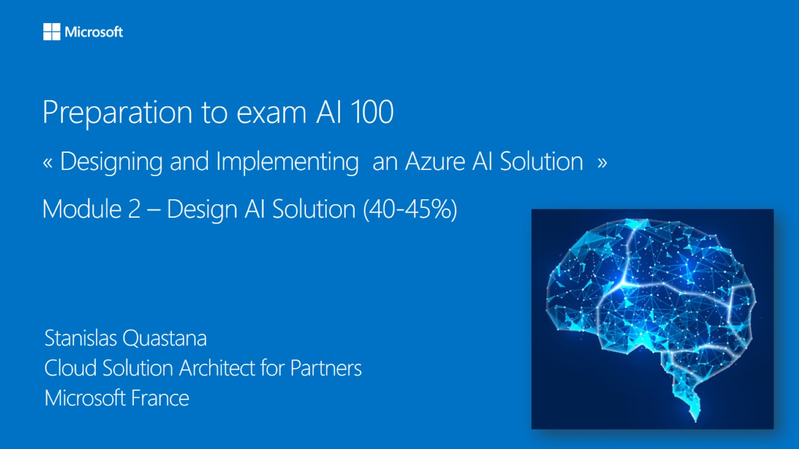

Meet Bhagdev
Program Manager
Microsoft

Slide 2
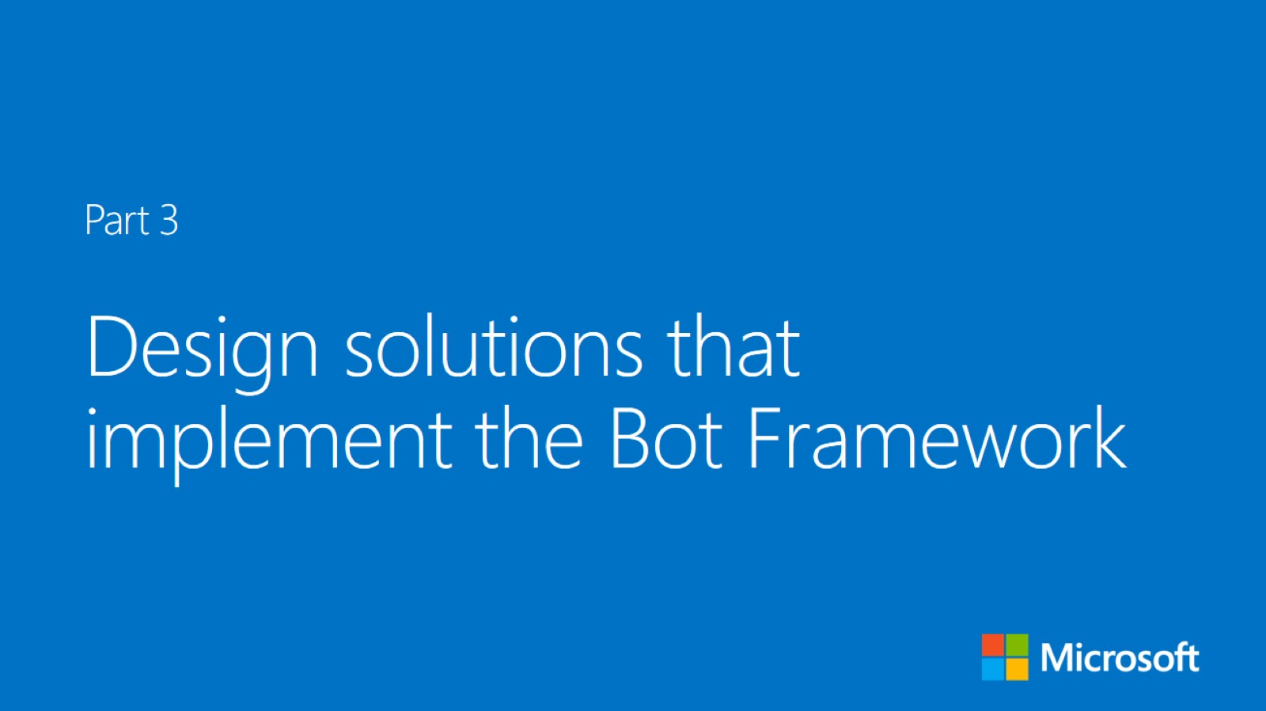


Slide 3
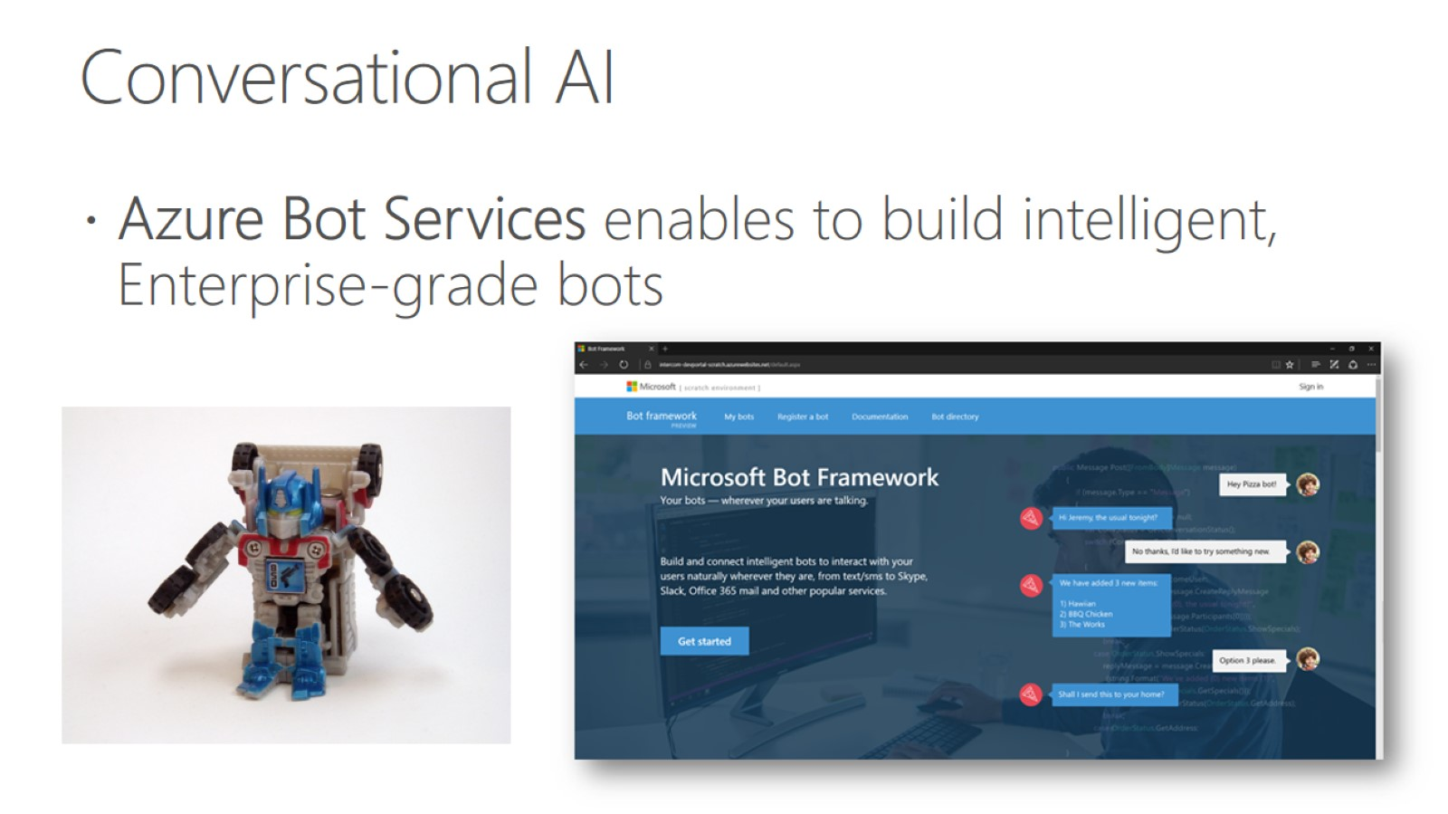
Conversational AI

Slide 4
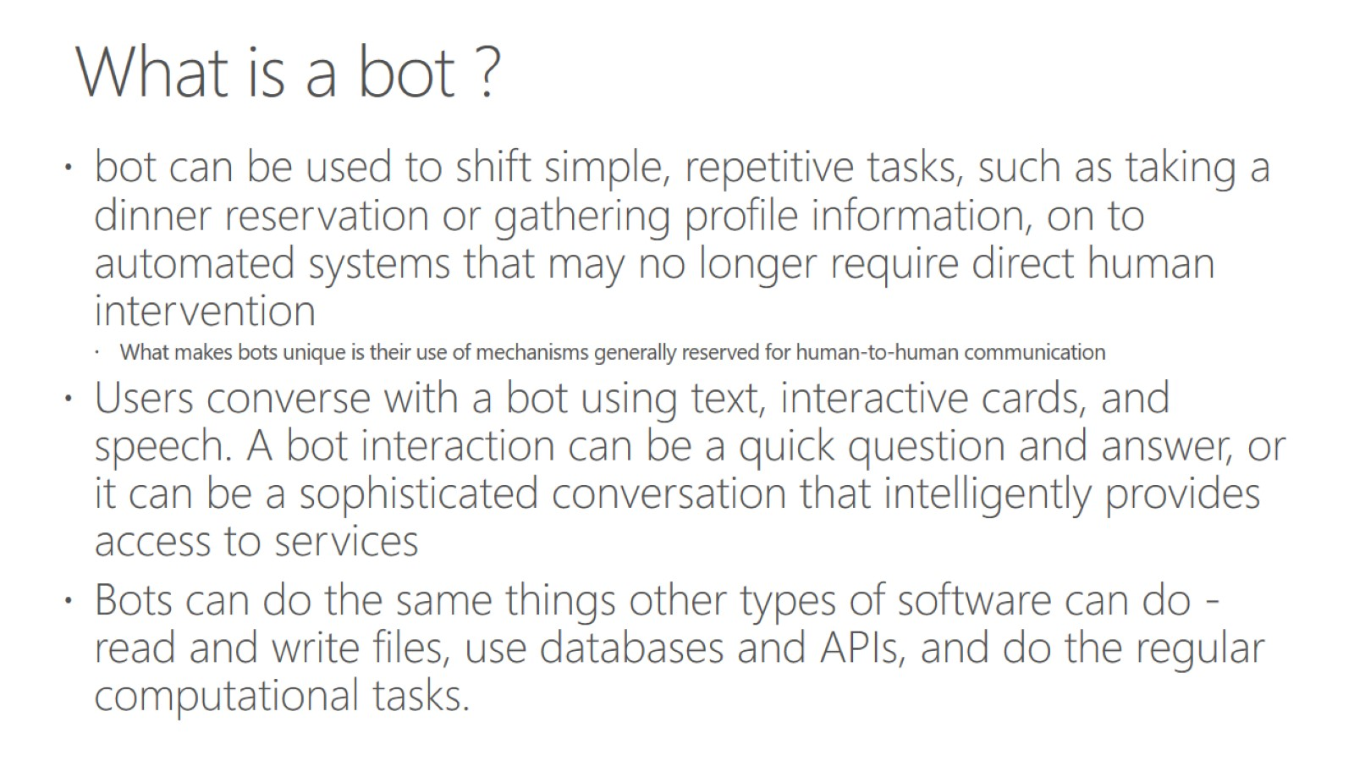
What is a bot ?

Slide 5
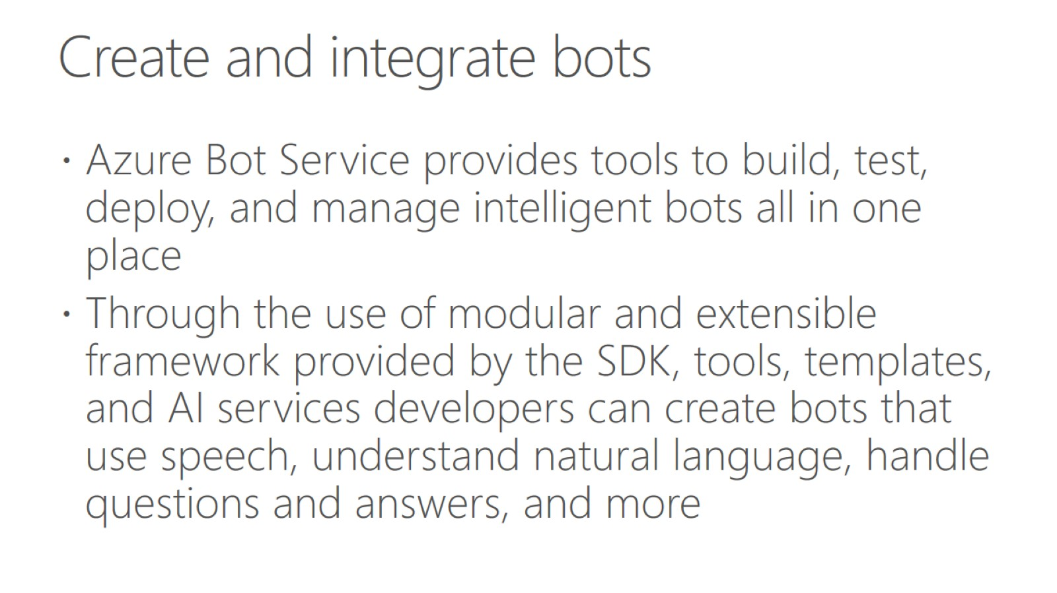
Create and integrate bots

Slide 6
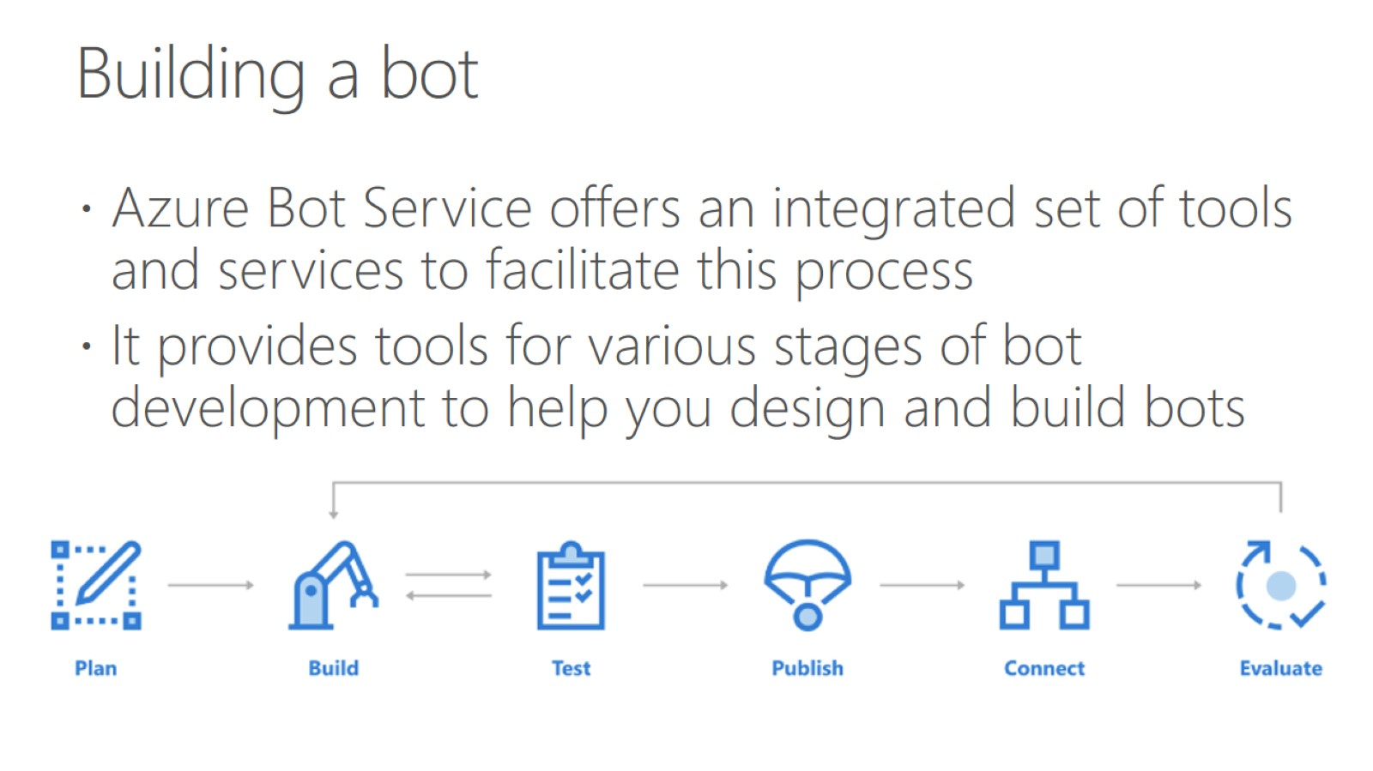
Building a bot

Slide 7
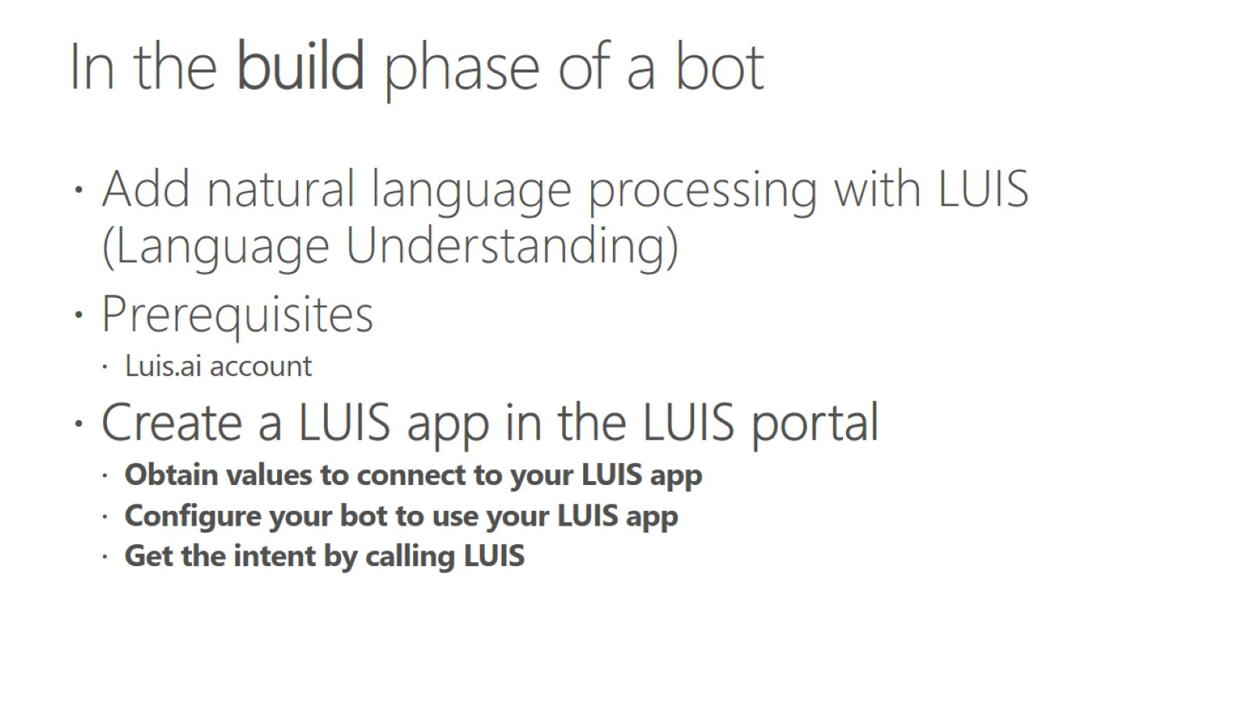
In the build phase of a bot

Slide 8
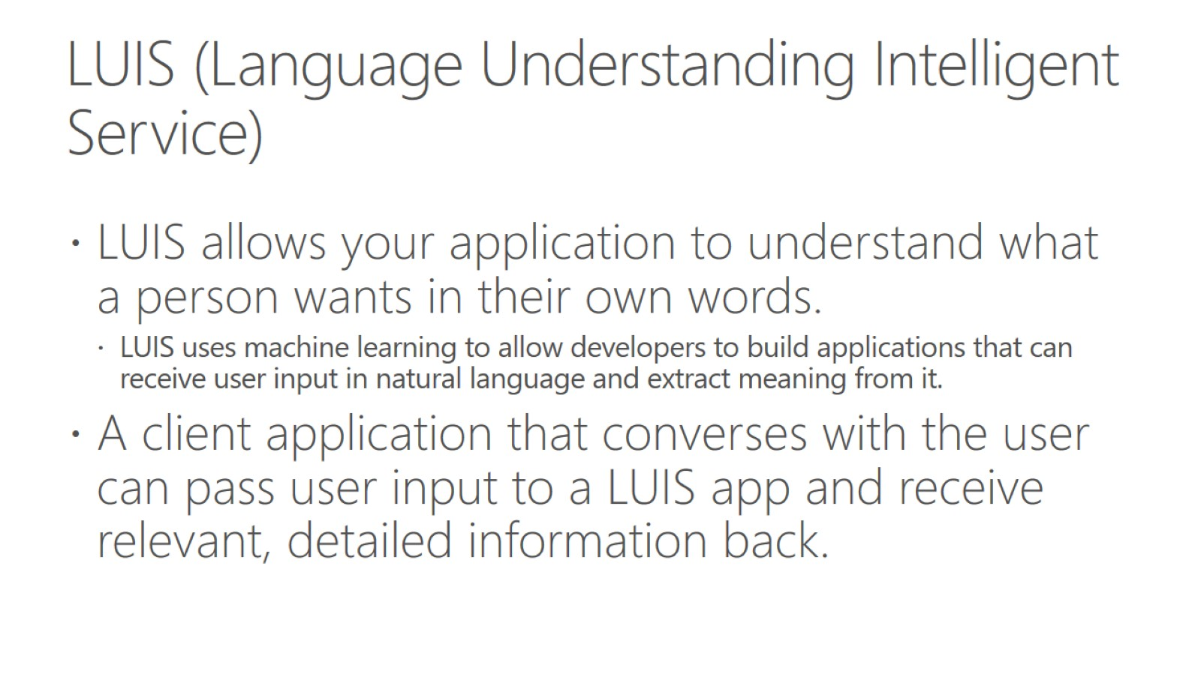
LUIS (Language Understanding Intelligent Service)

Slide 9
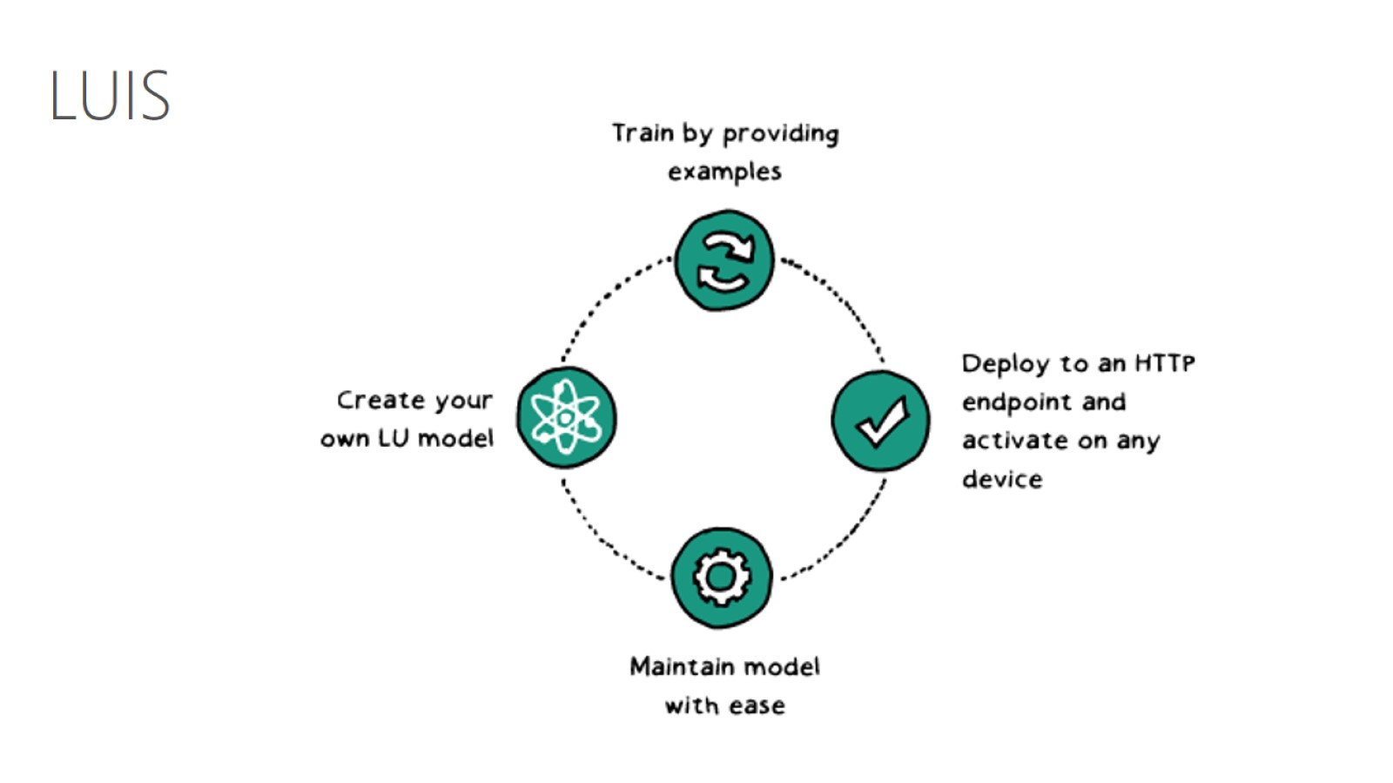

Slide 10
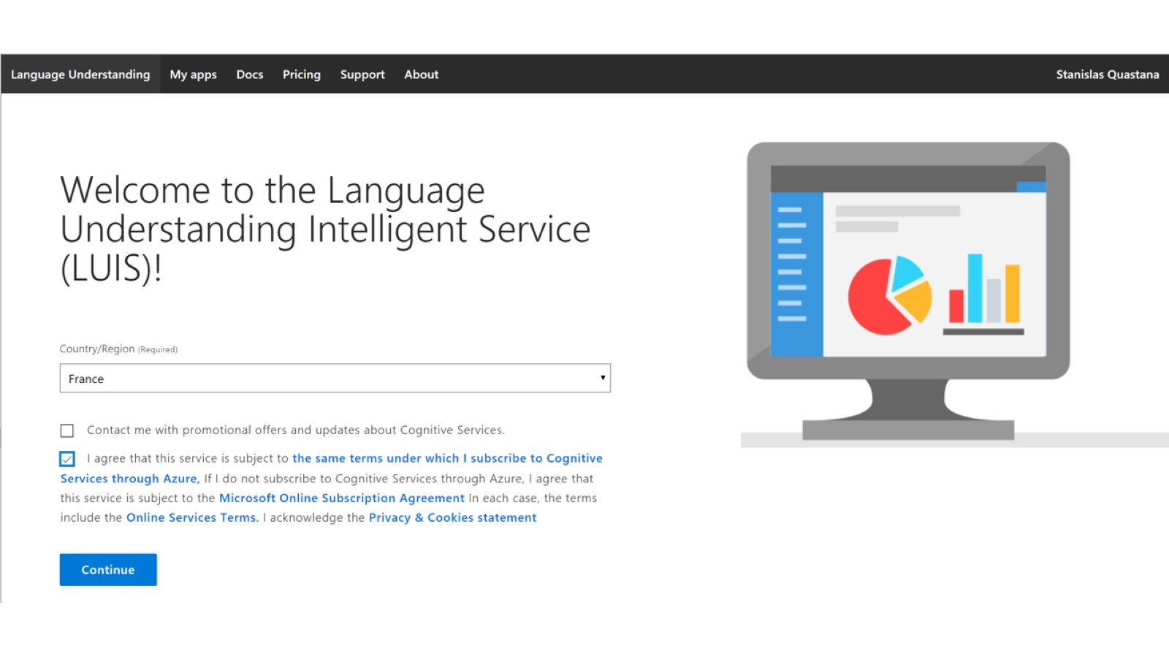

Slide 11
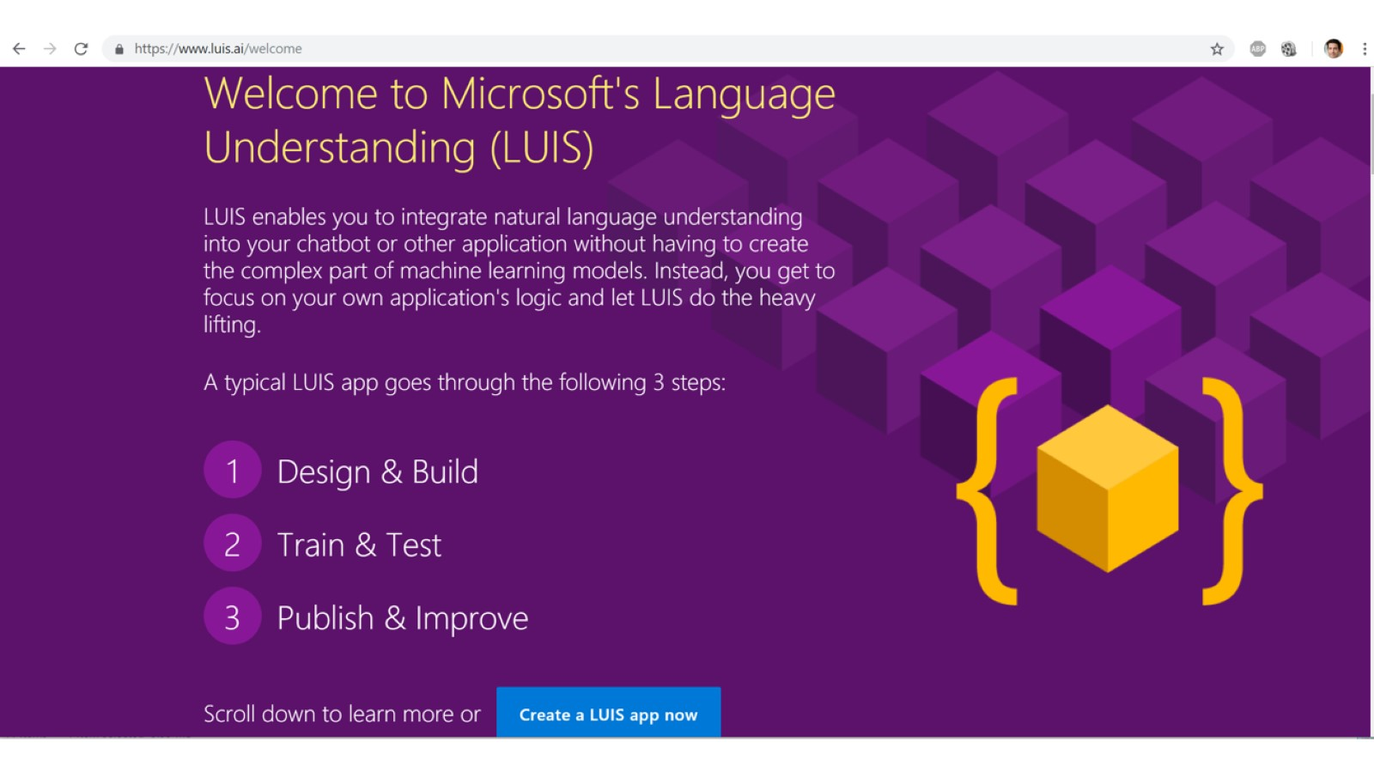

Slide 12
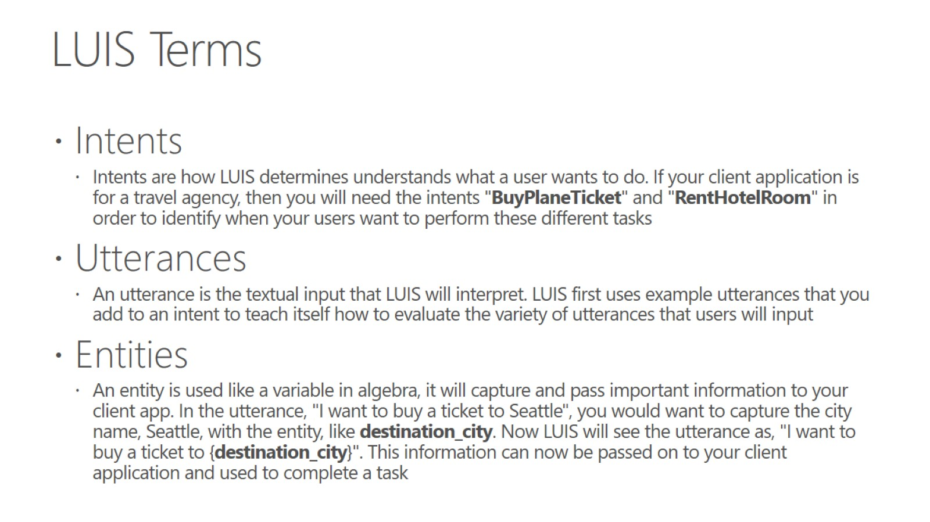
LUIS Terms

Slide 13
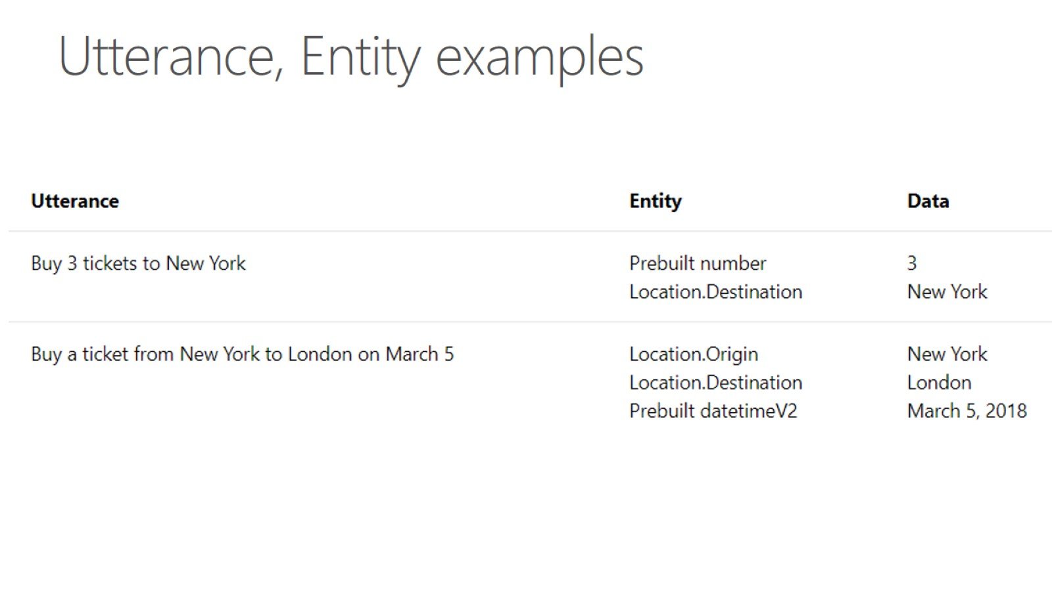
Utterance, Entity examples

Slide 14
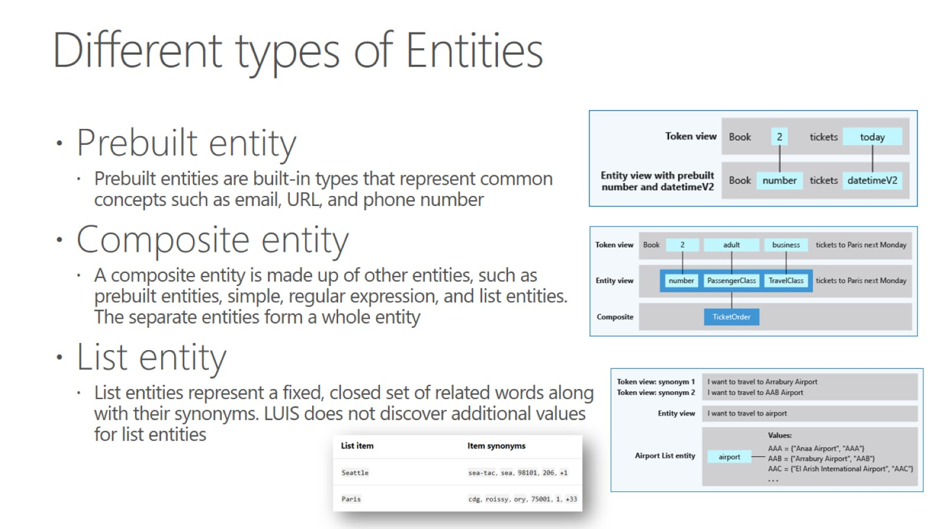
Different types of Entities

Slide 15
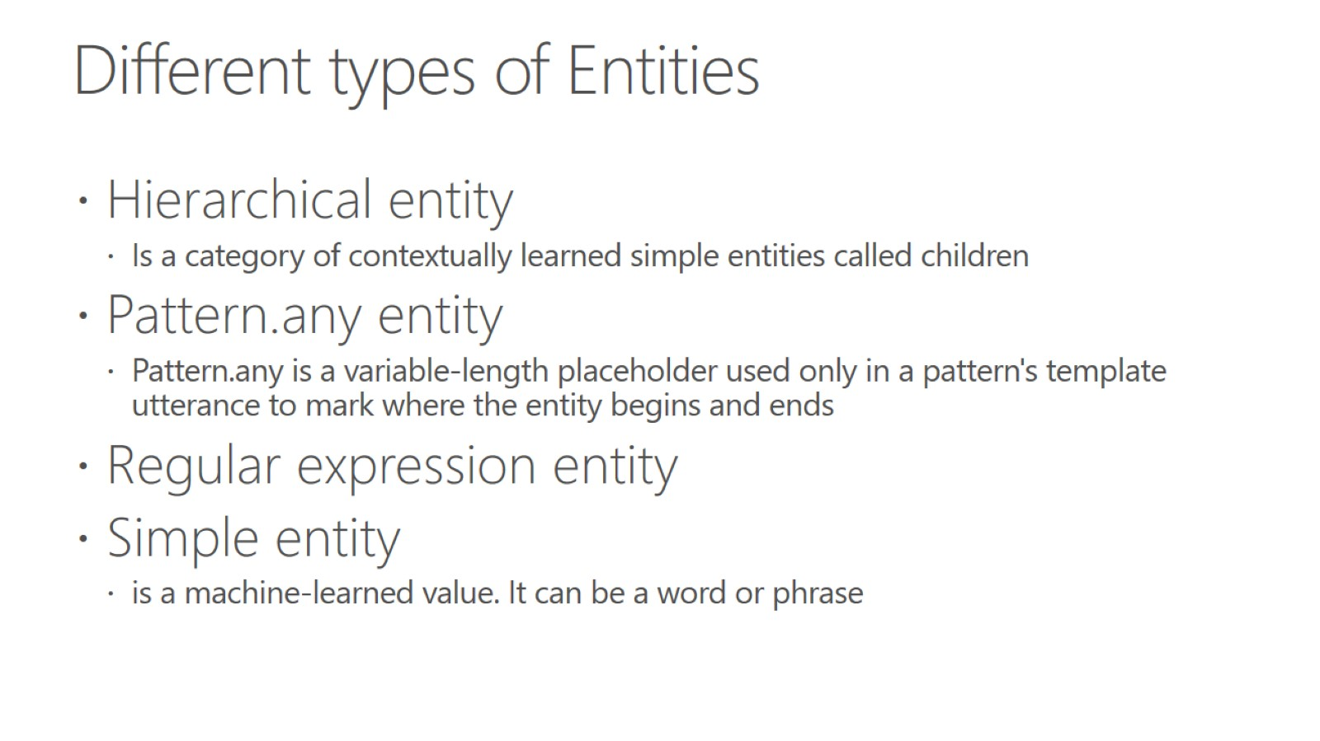
Different types of Entities

Slide 16
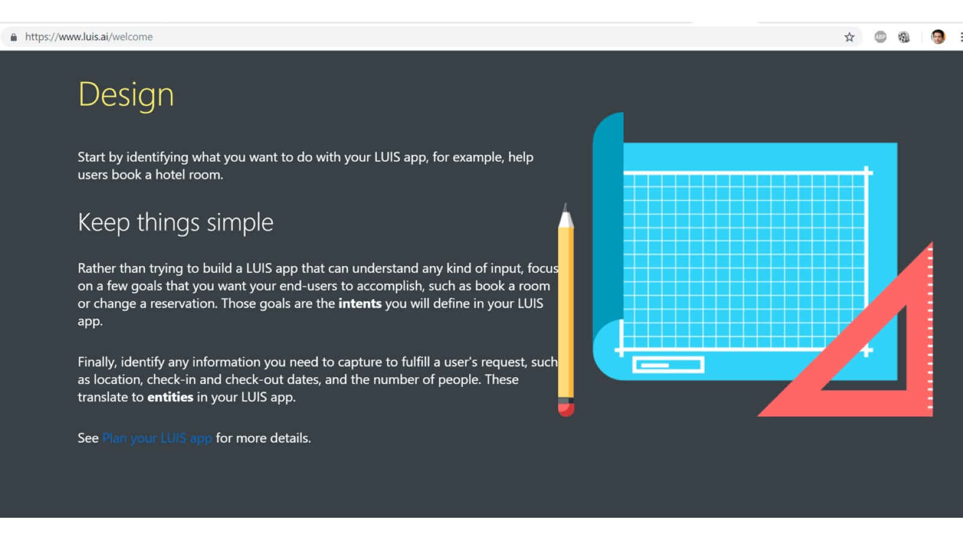

Slide 17
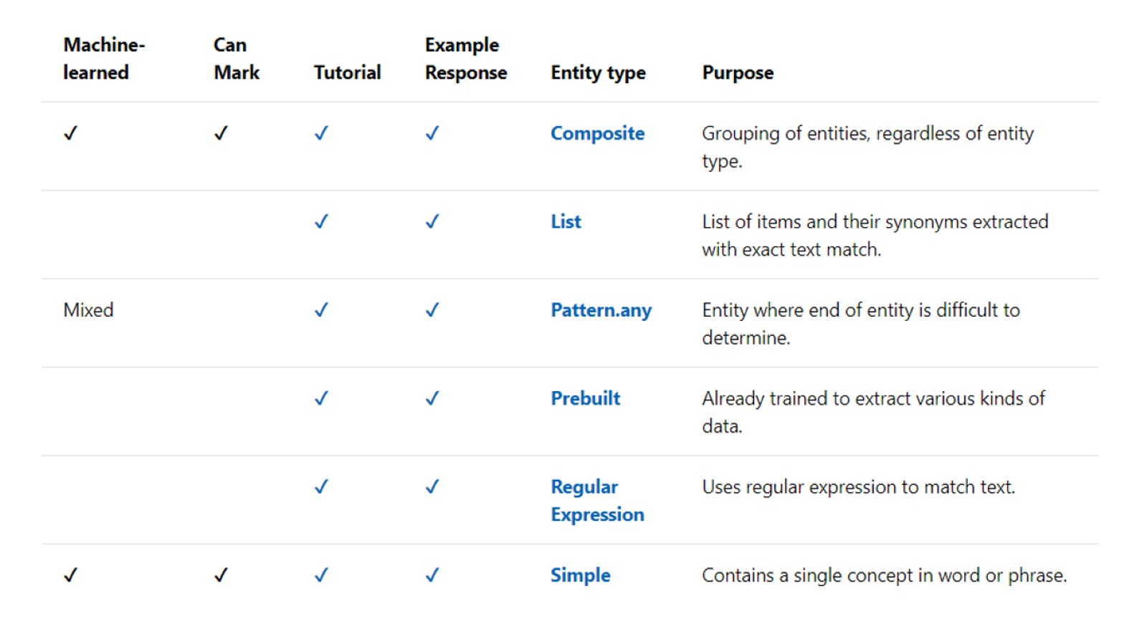

Slide 18
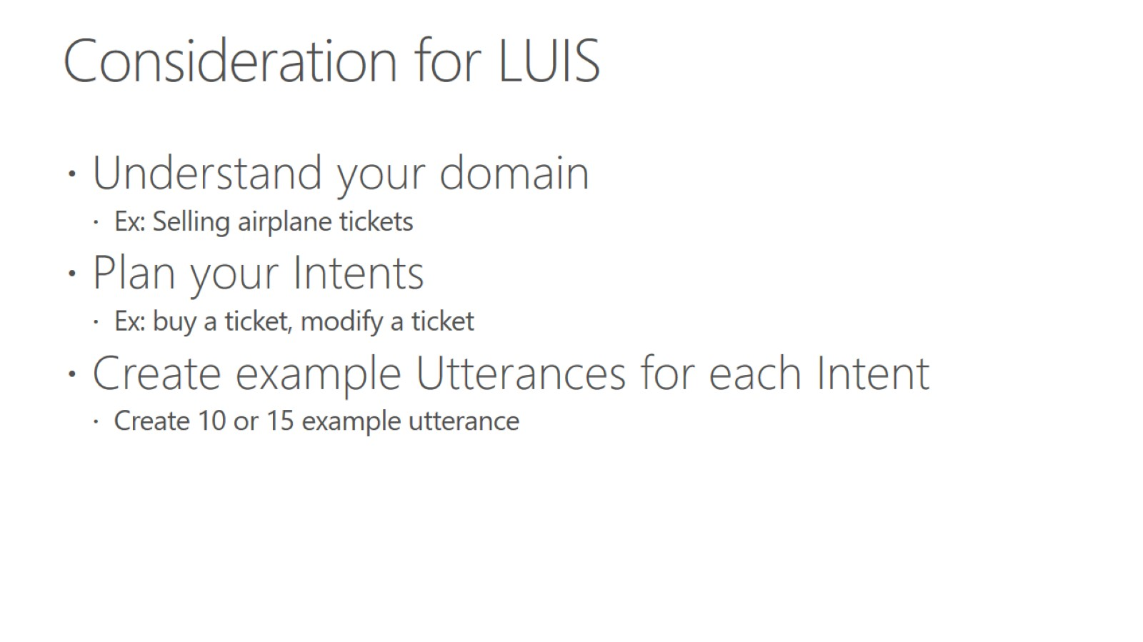
Consideration for LUIS

Slide 19
Hands on lab - Add conversational intelligence to your apps by using Language Understanding Intelligent Service (LUIS)
To access the lab go here - https://docs.microsoft.com/en-us/learn/modules/create-and-publish-a-luis-model/1-introduction
Let me know if you have any questions

Slide 20
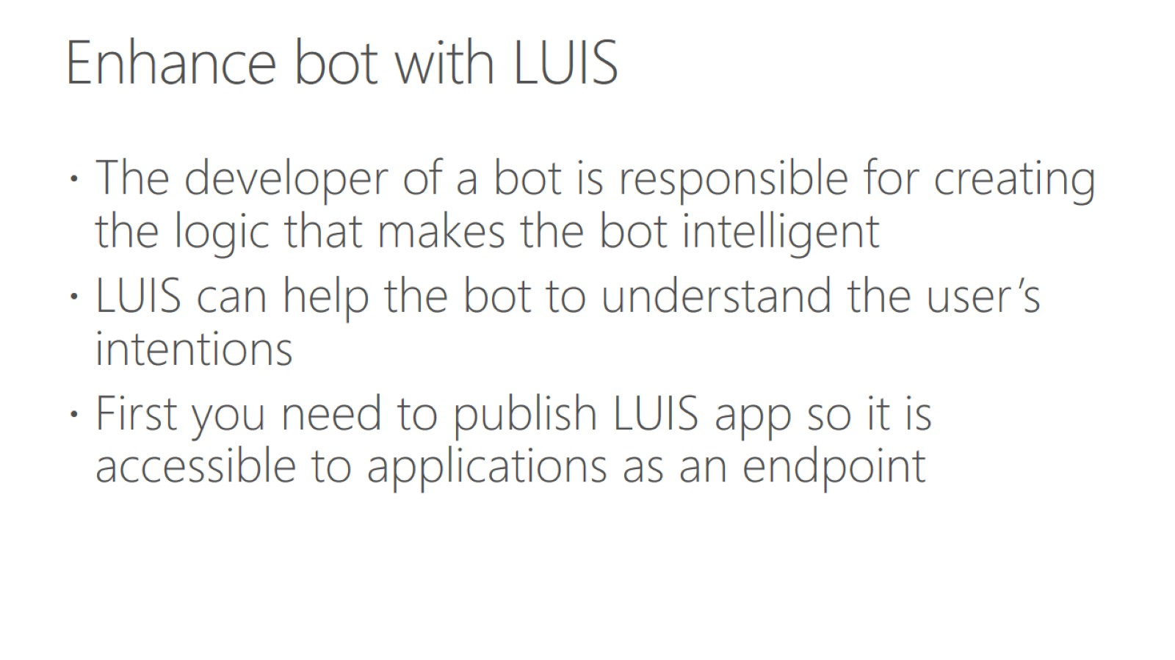
Enhance bot with LUIS

Slide 21
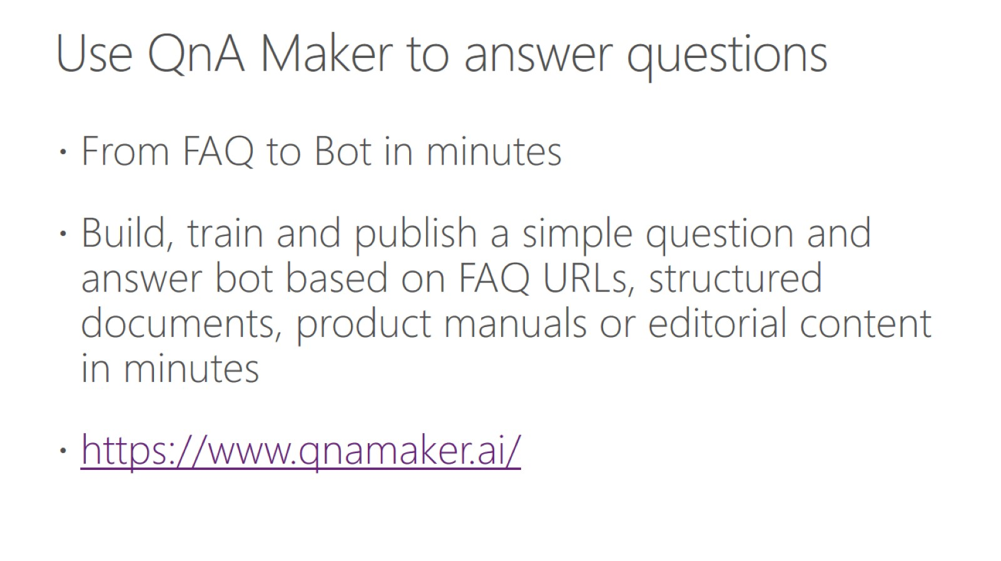
Use QnA Maker to answer questions

Slide 22
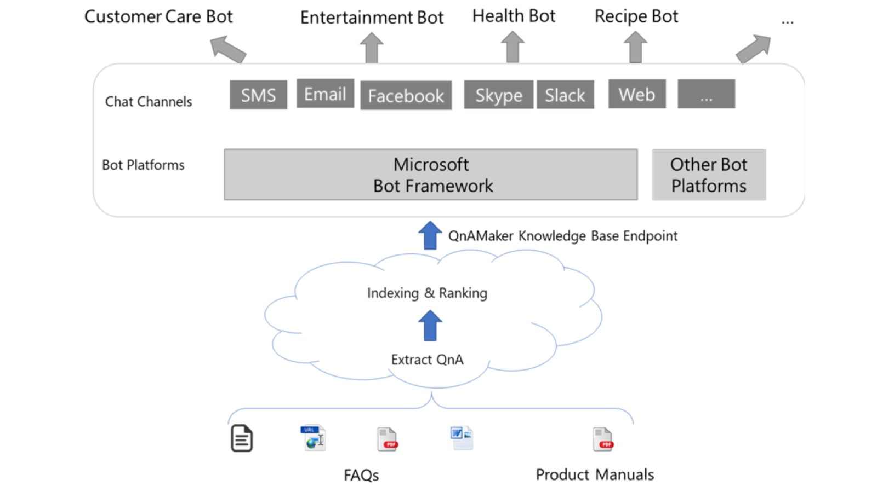

Slide 23
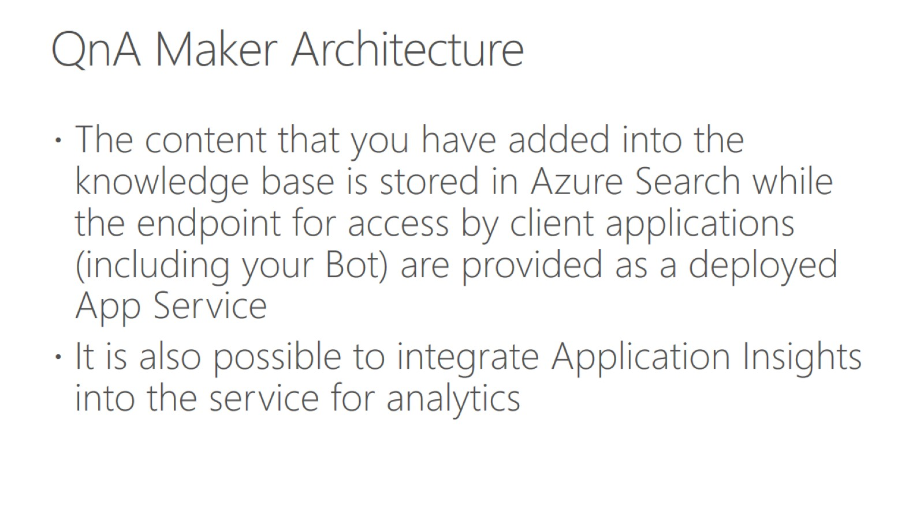
QnA Maker Architecture

Slide 24
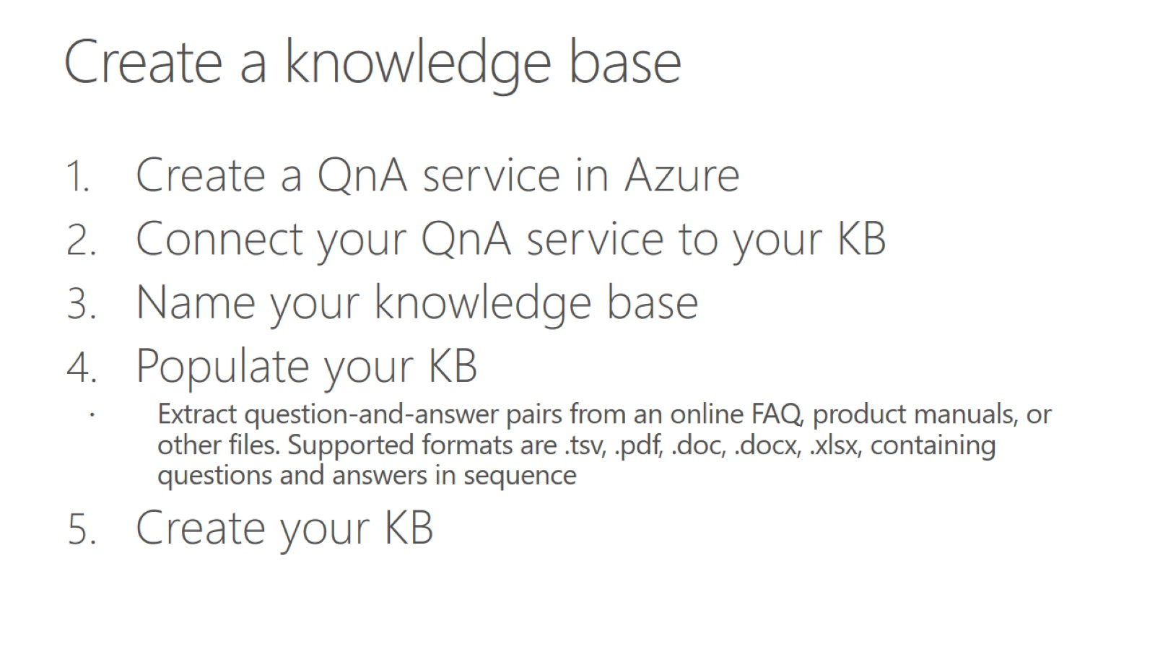
Create a knowledge base

Slide 25
Hands on lab - Build an FAQ chatbot with QnA Maker and Azure Bot Service
To access the lab go here - https://docs.microsoft.com/en-us/learn/modules/build-a-faq-chat-bot-with-qna-maker-and-azure-bot-service/1-introduction
Let me know if you have any questions

Slide 26
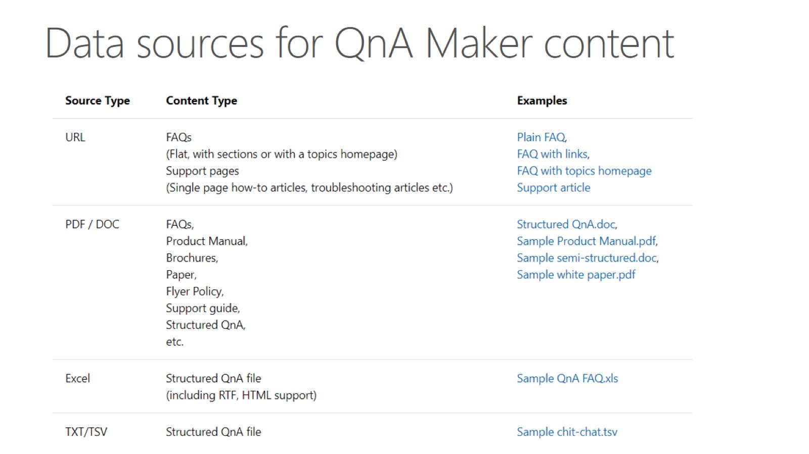
Data sources for QnA Maker content

Slide 27
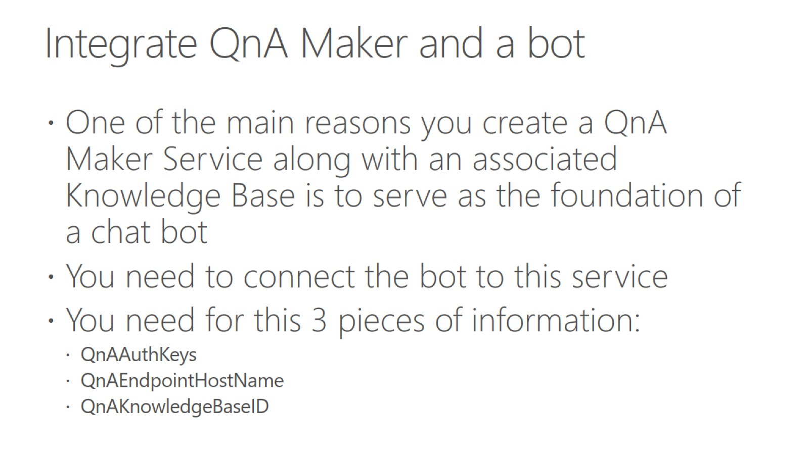
Integrate QnA Maker and a bot

Slide 28
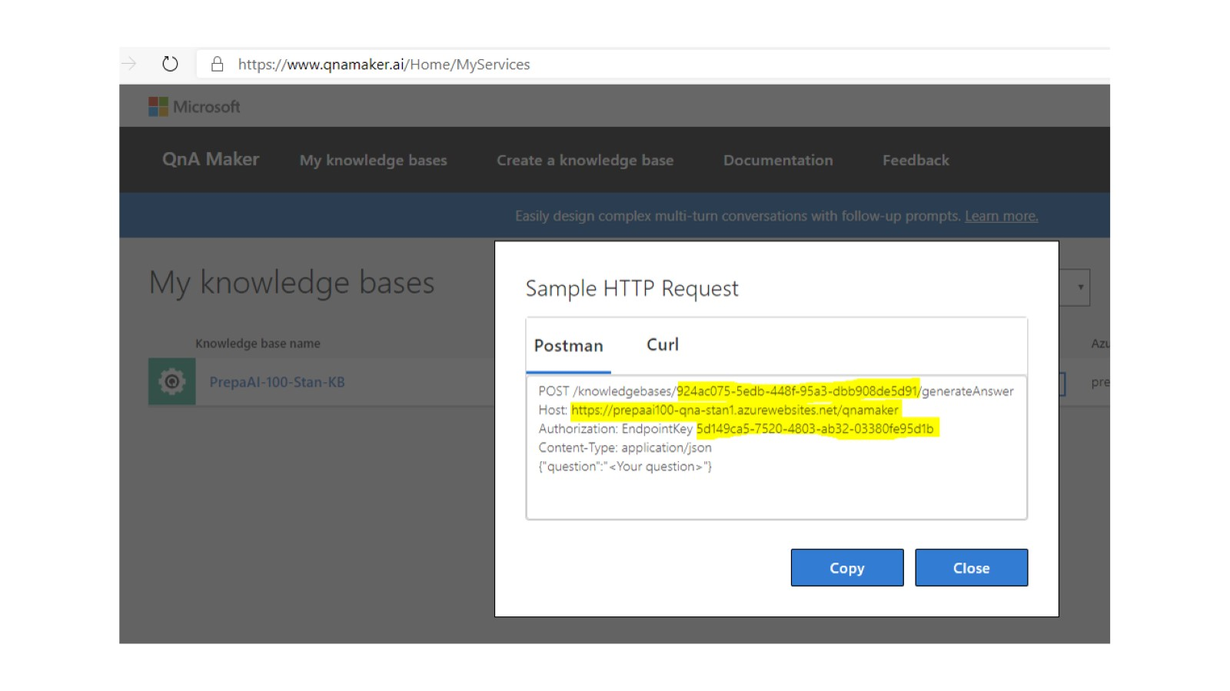

Slide 29
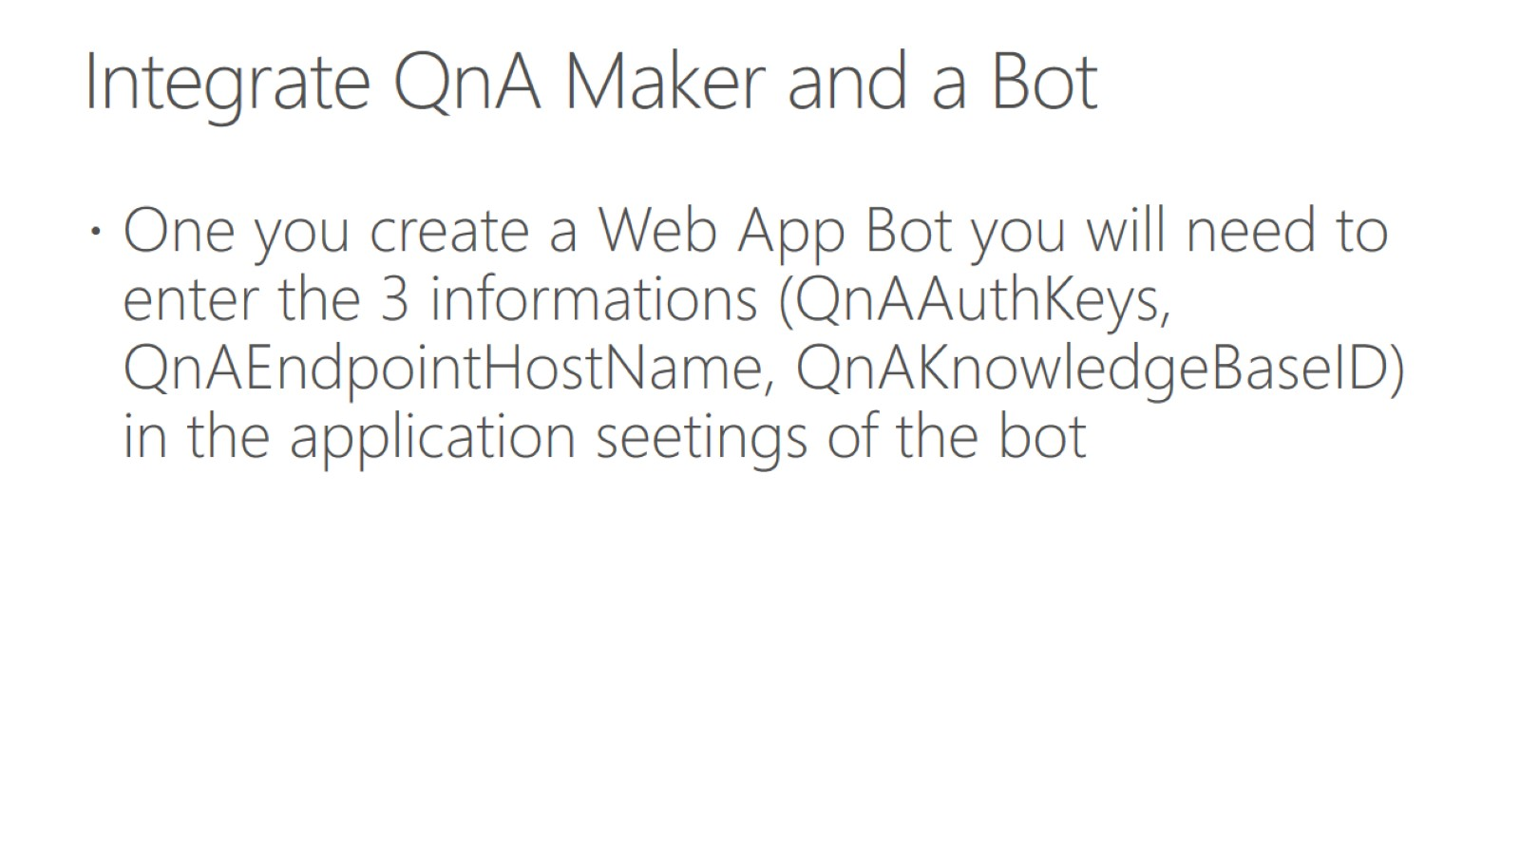
Integrate QnA Maker and a Bot

Slide 30
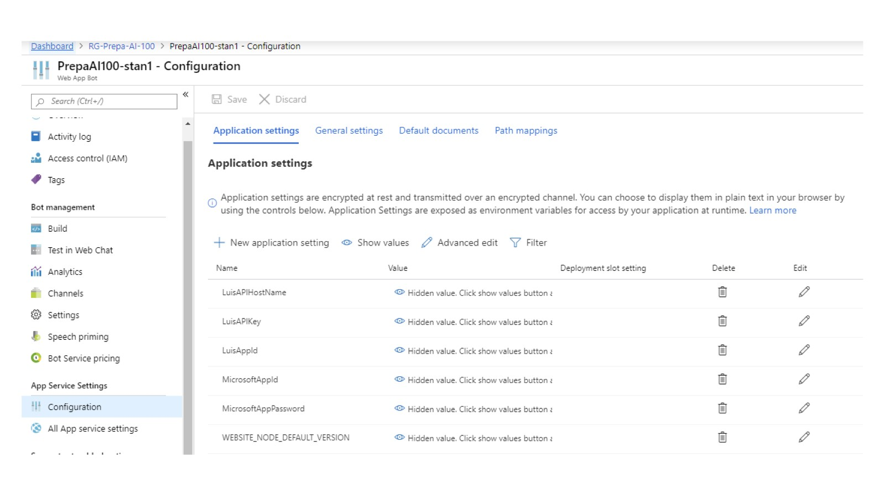

Slide 31
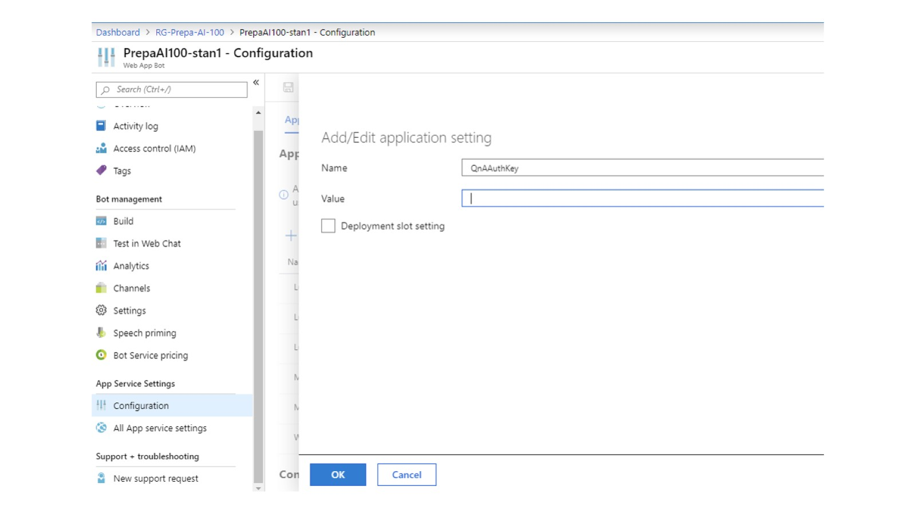

Slide 32
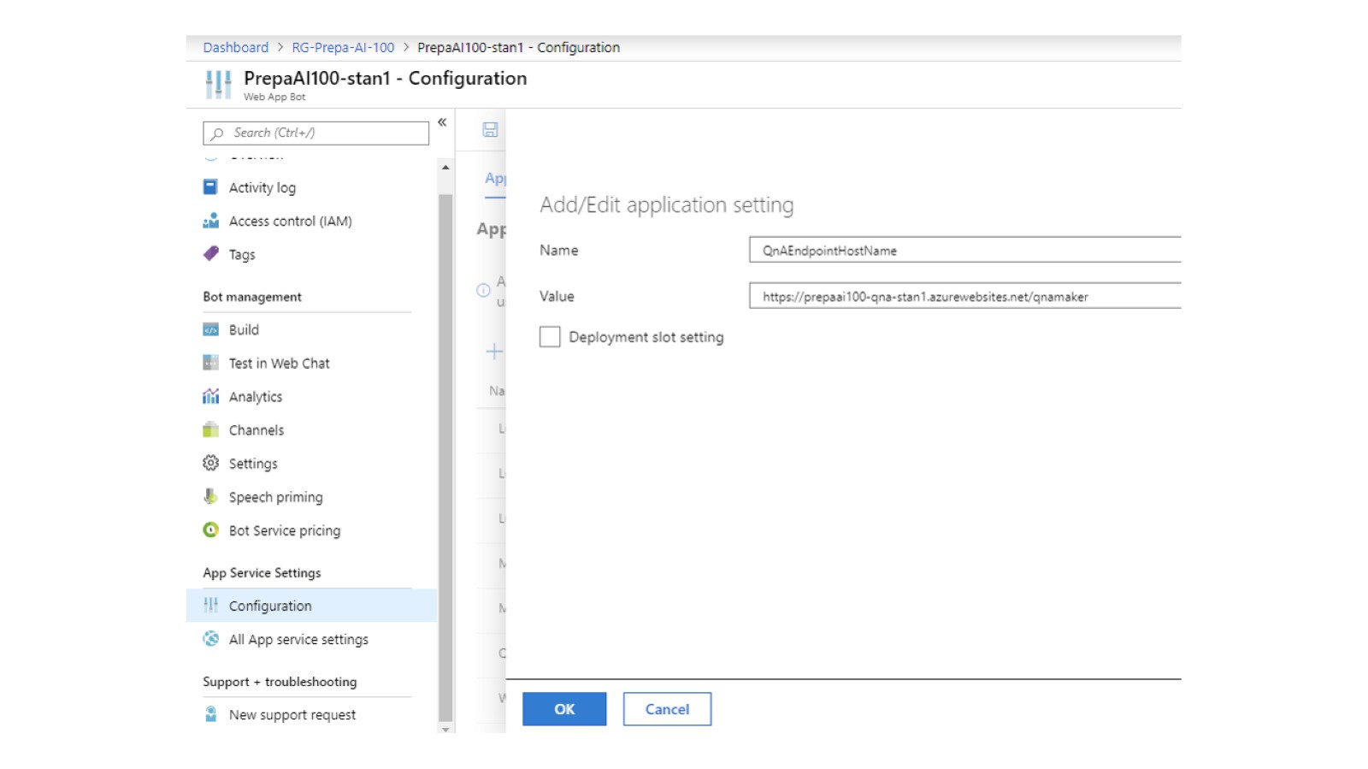

Slide 33
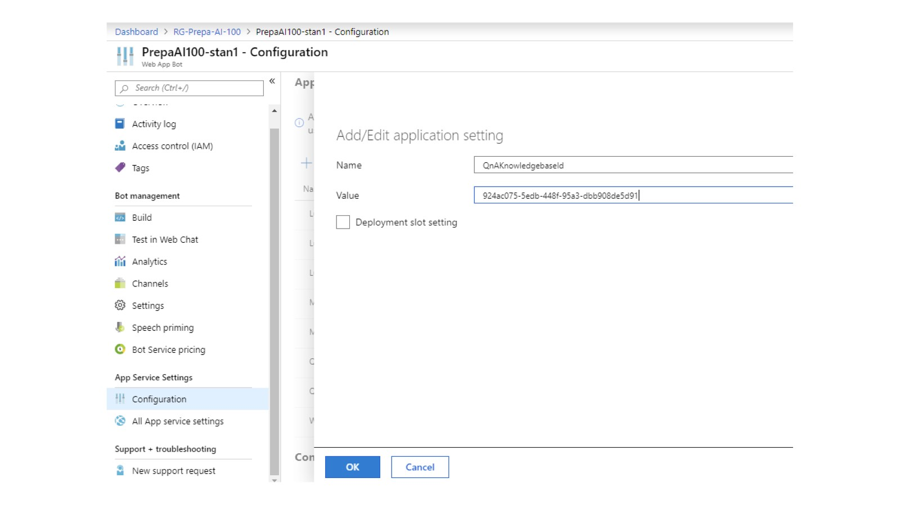

Slide 34
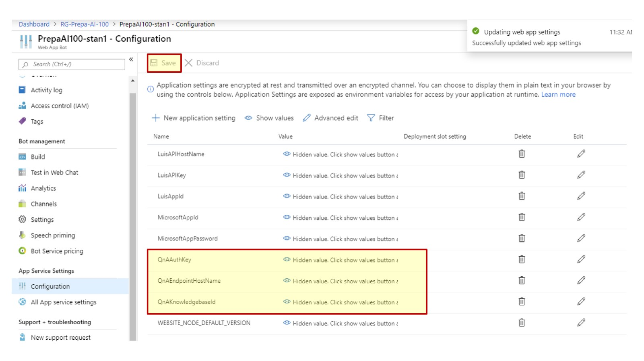

Slide 35
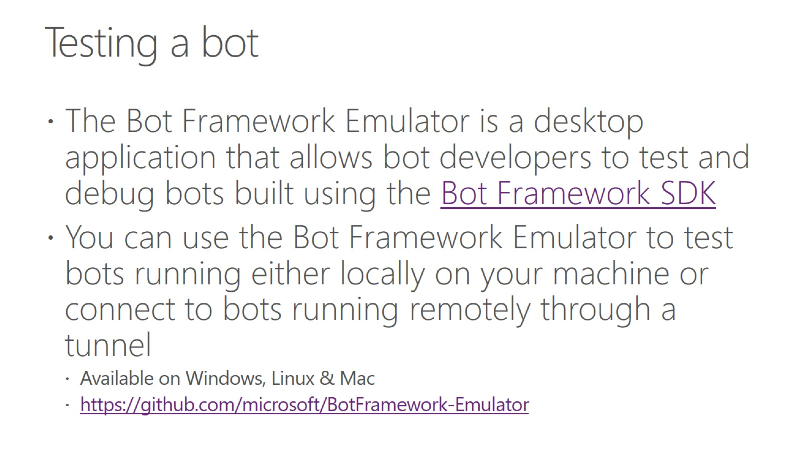
Testing a bot

Slide 36
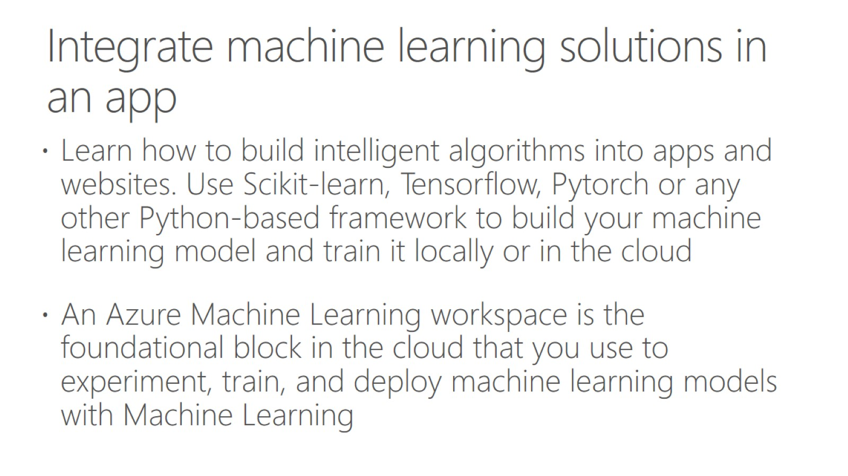
Integrate machine learning solutions in an app

Slide 37
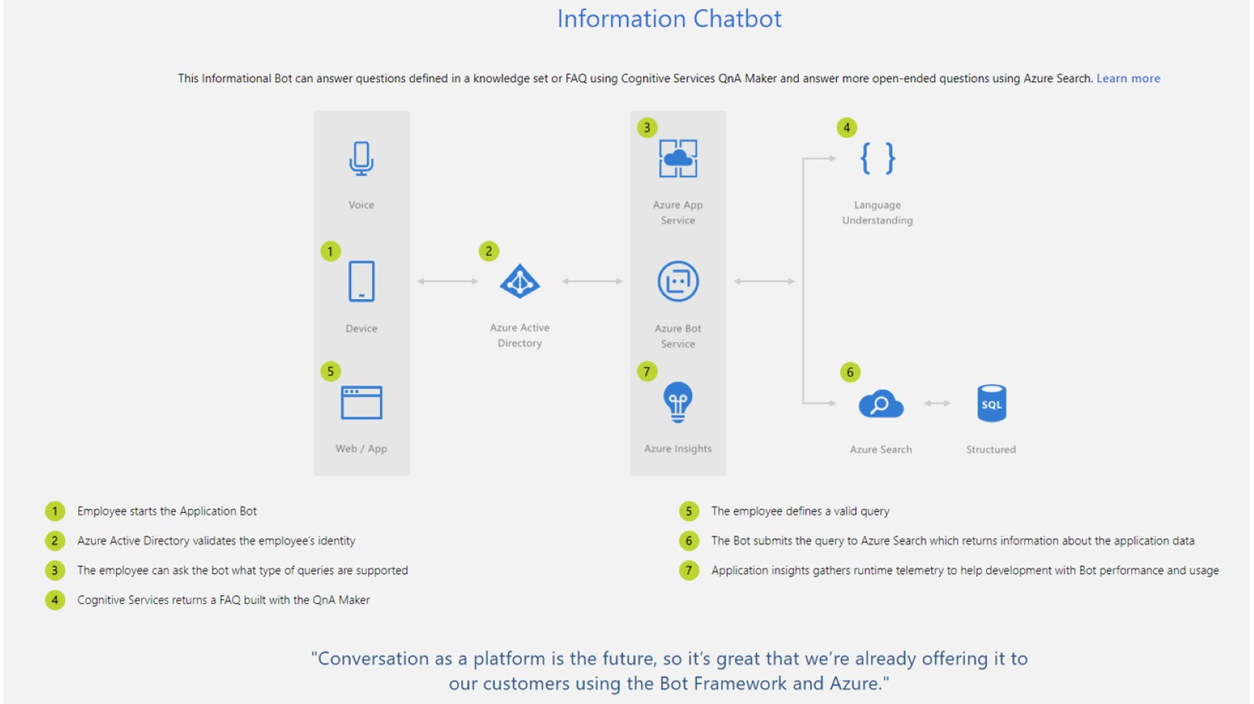

Slide 38
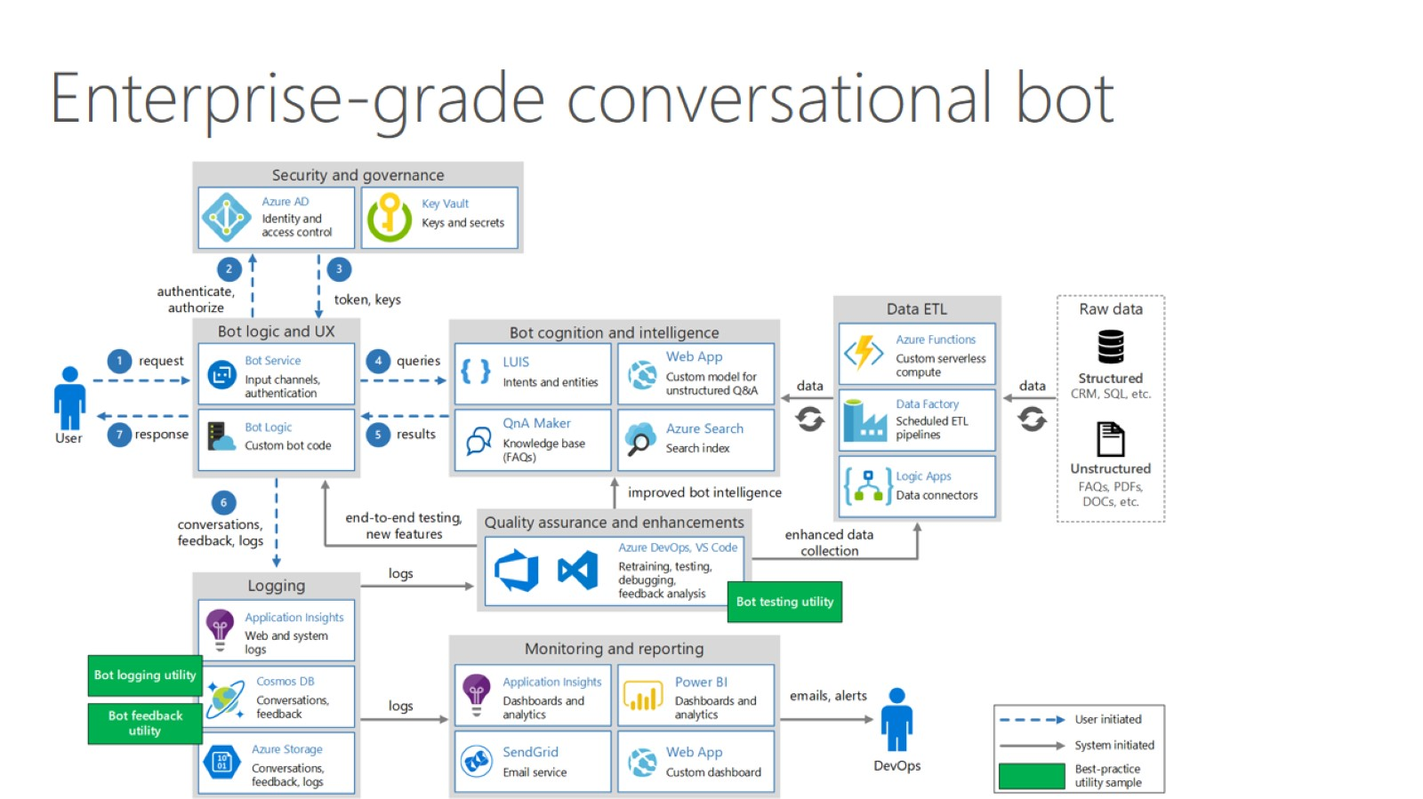

Slide 39
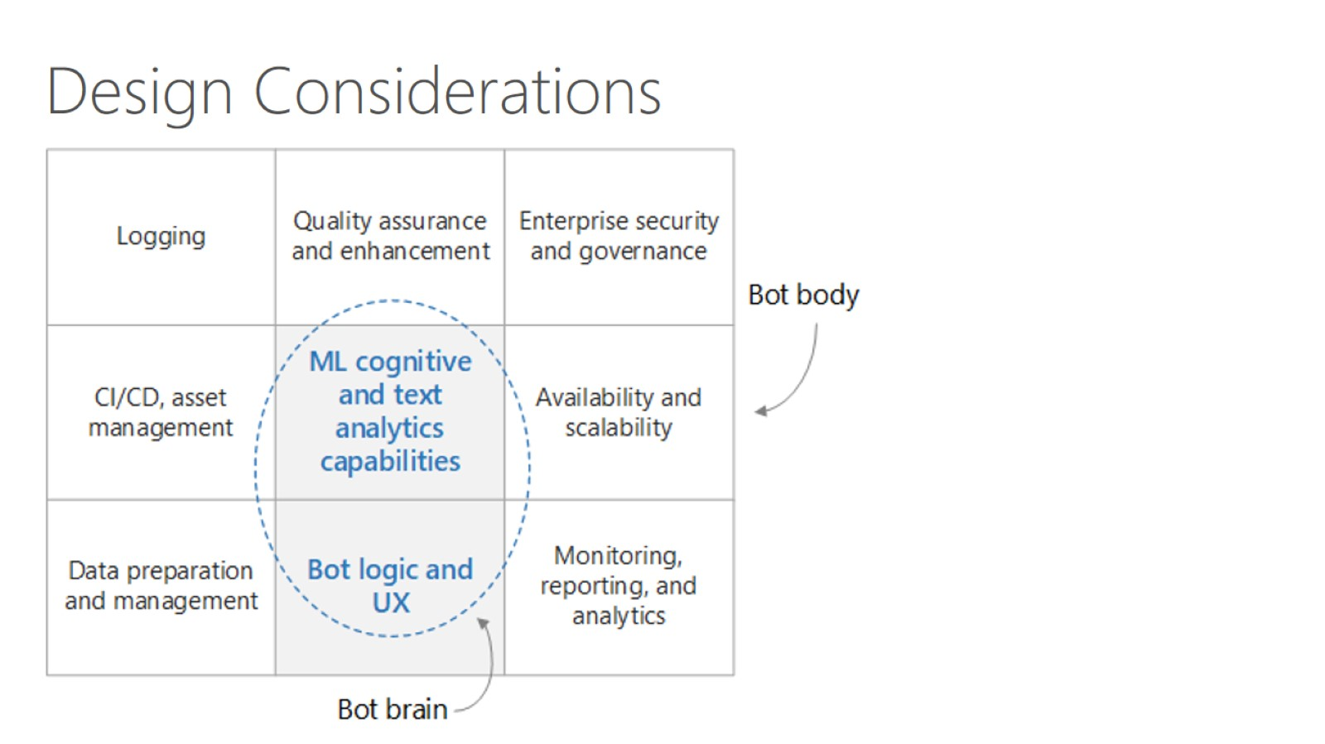

Slide 40
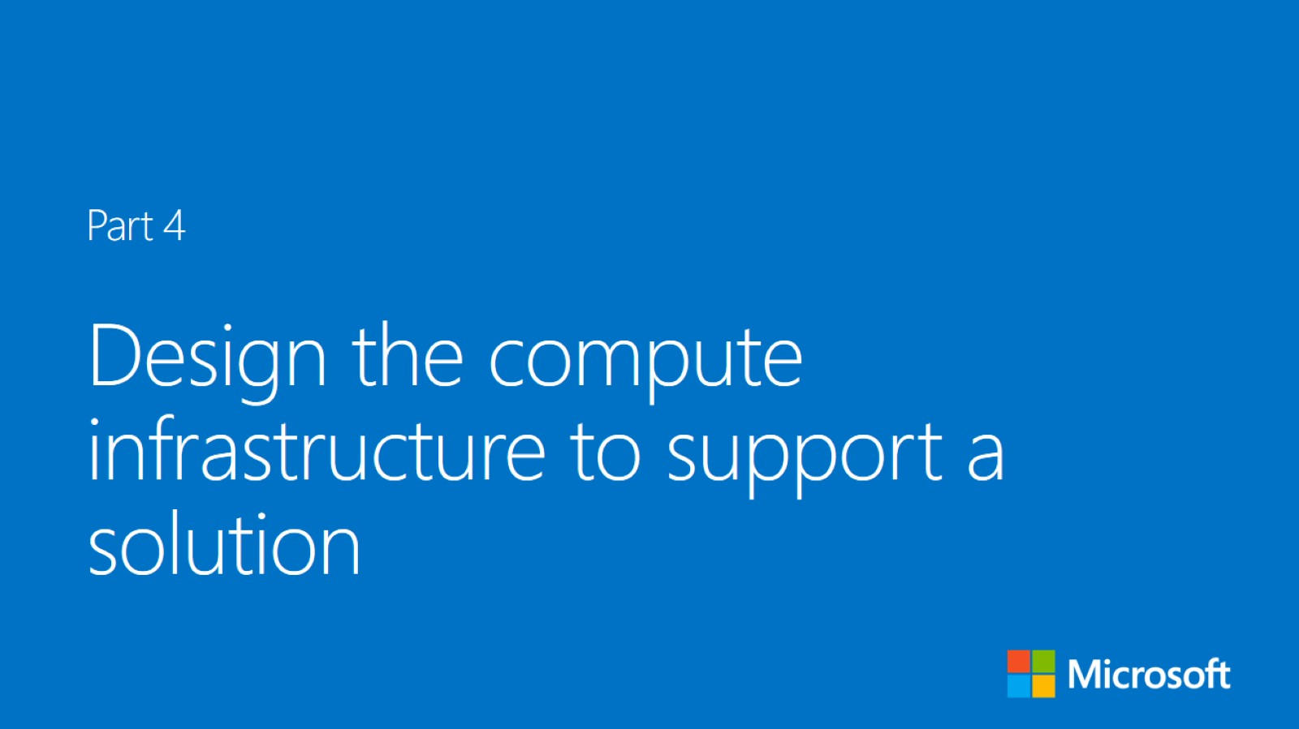

Slide 41
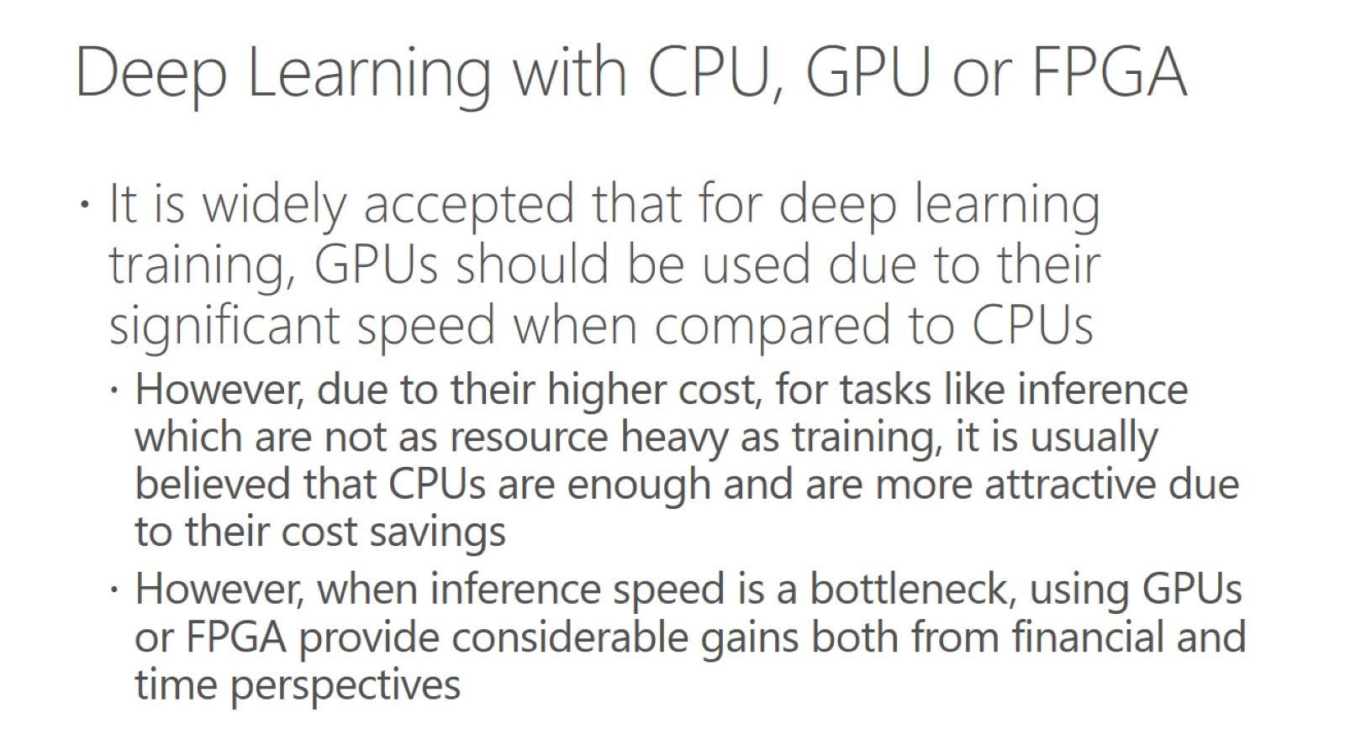
Deep Learning with CPU, GPU or FPGA

Slide 42
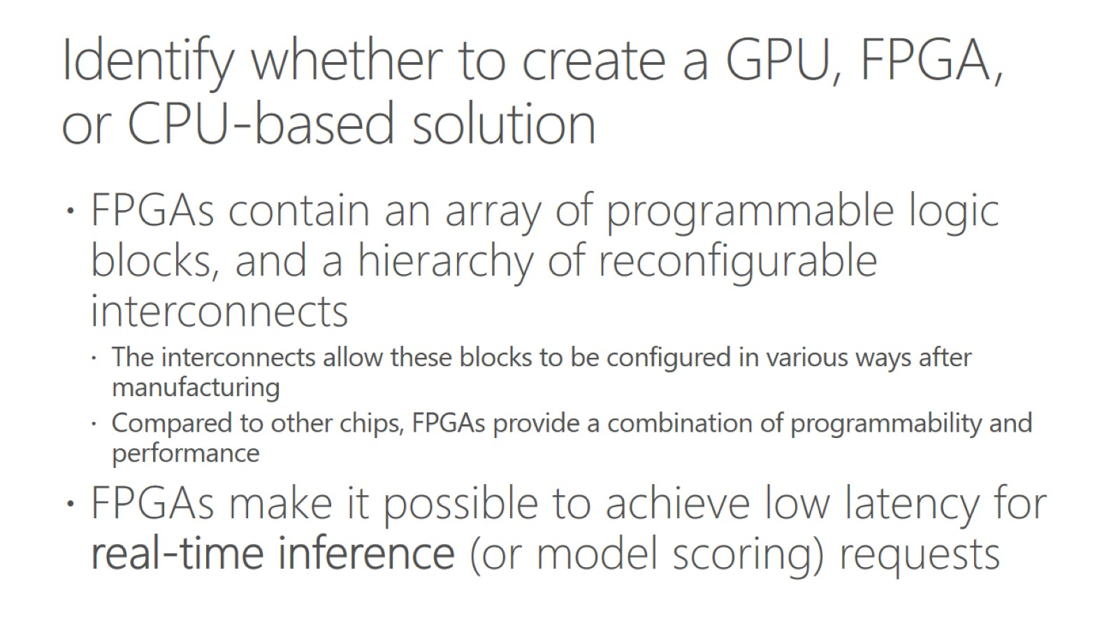
Identify whether to create a GPU, FPGA, or CPU-based solution

Slide 43
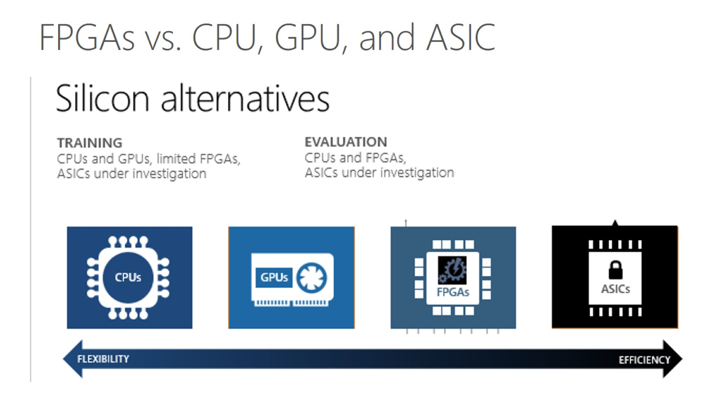
FPGAs vs. CPU, GPU, and ASIC

Slide 44
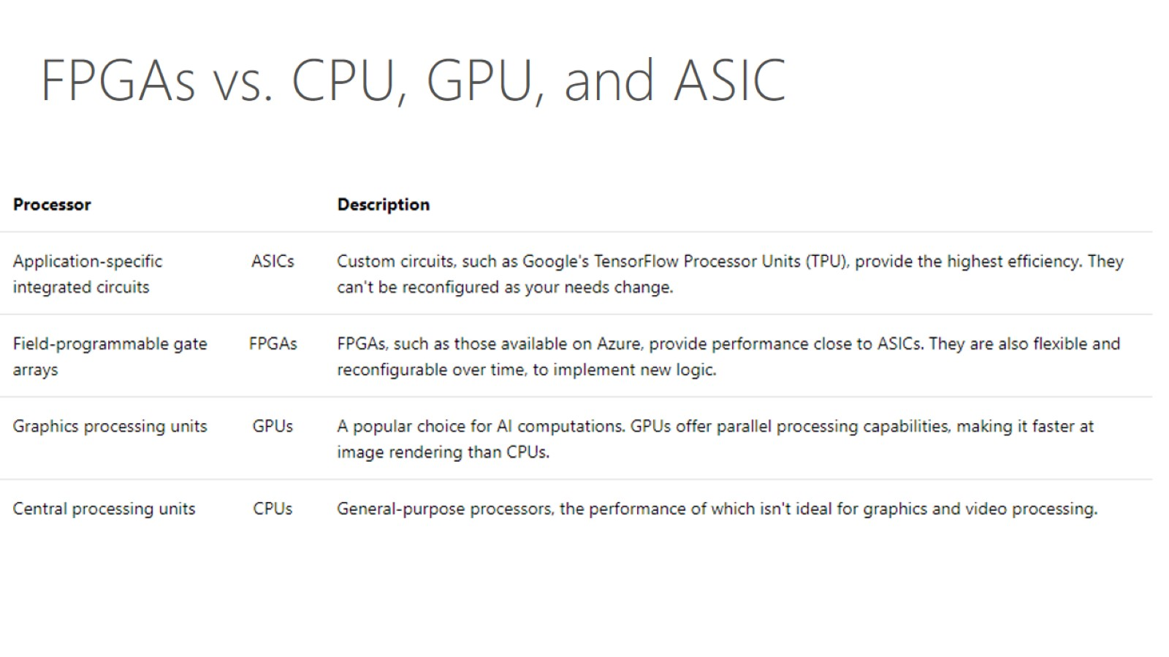

Slide 45
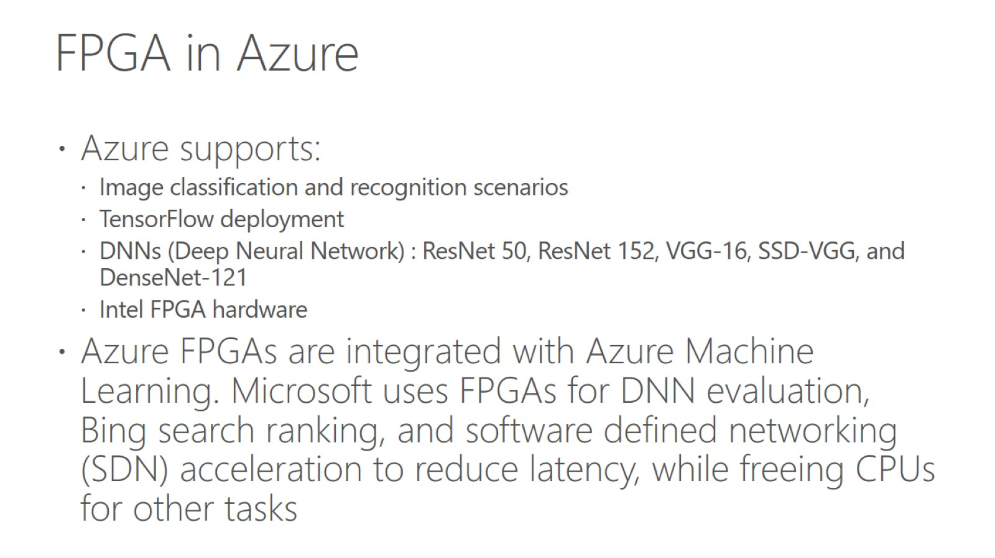
FPGA in Azure

Slide 46
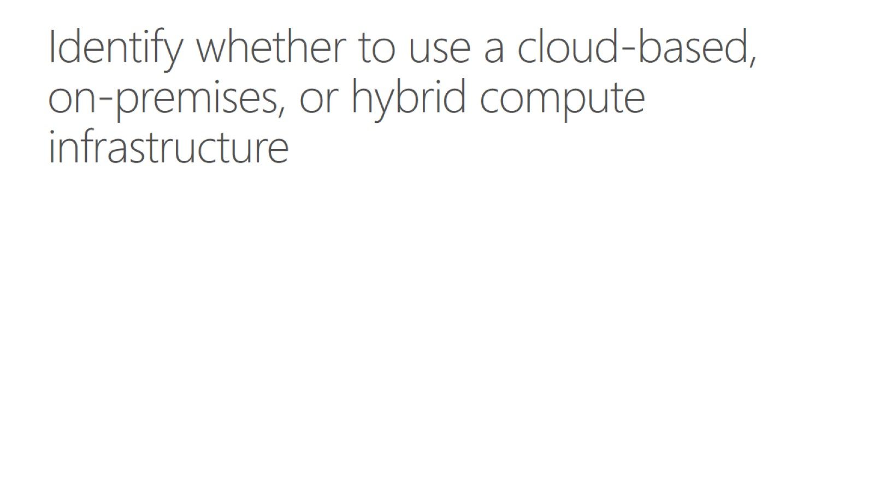
Identify whether to use a cloud-based, on-premises, or hybrid compute infrastructure

Slide 47
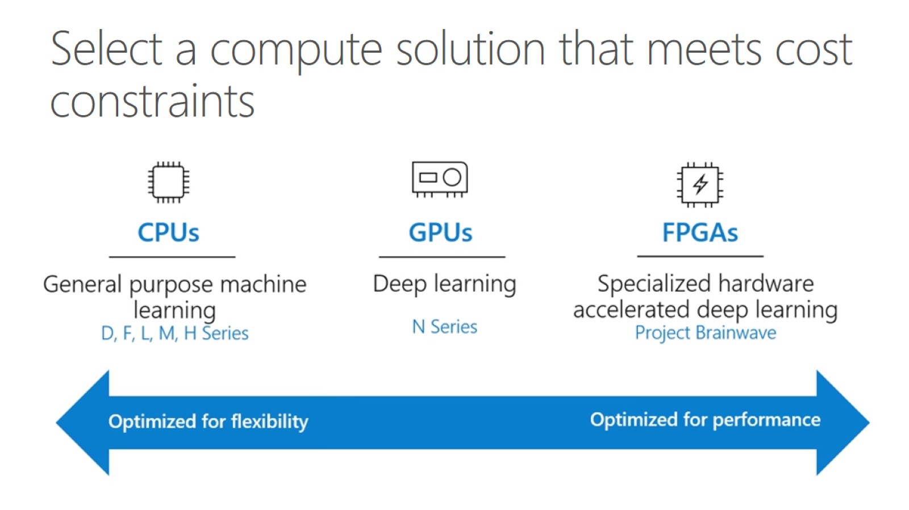
Select a compute solution that meets cost constraints

Slide 48
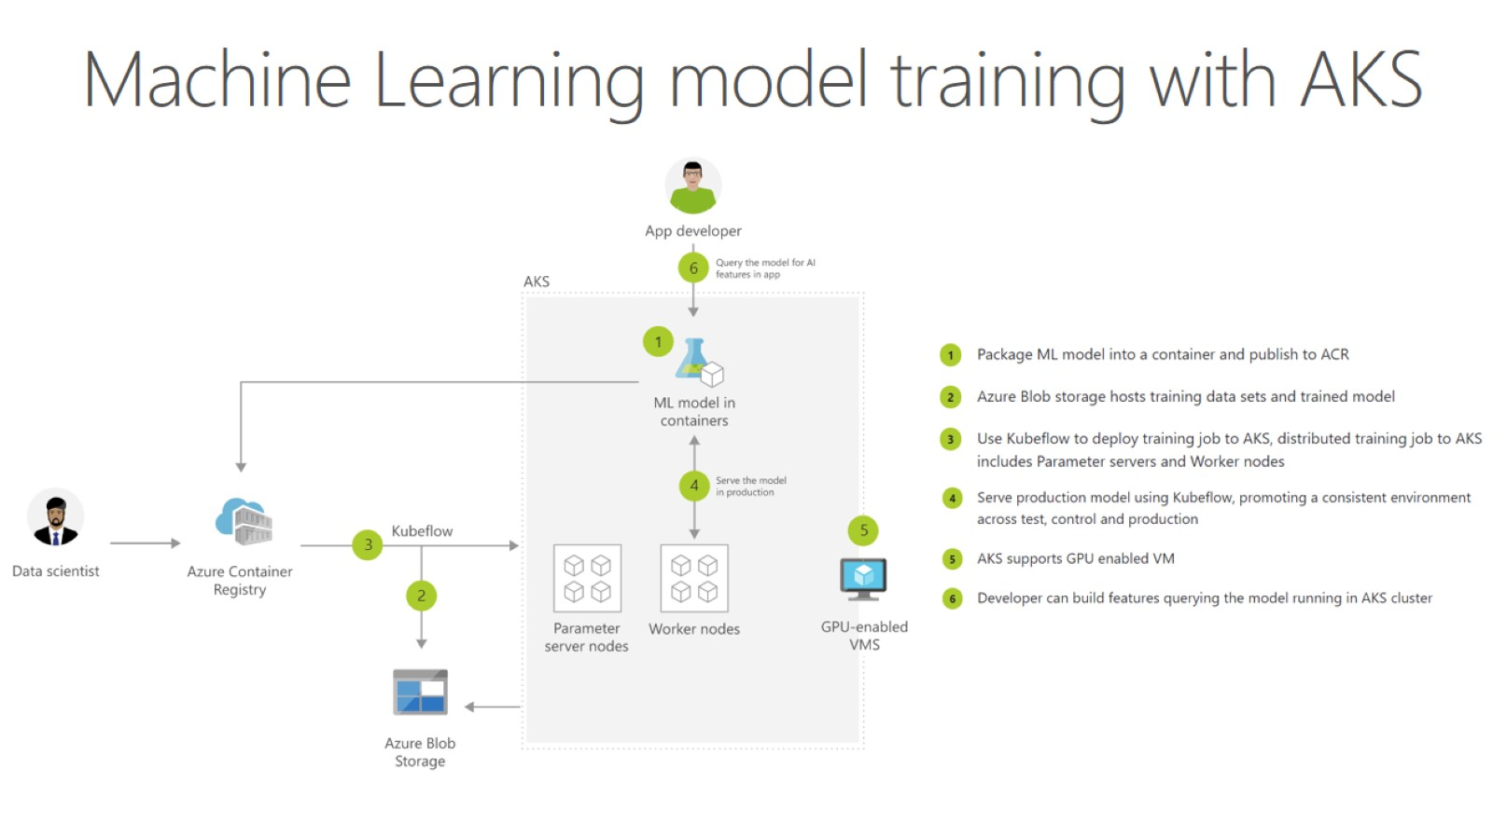
Machine Learning model training with AKS

Slide 49
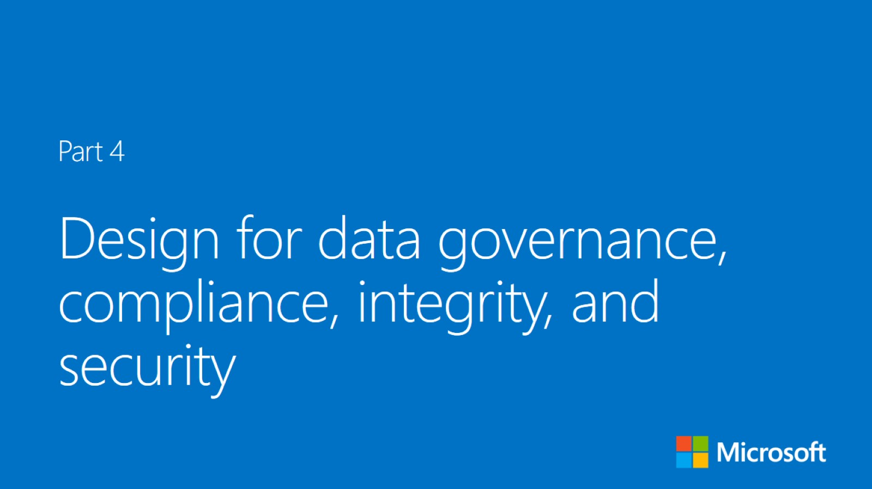

Slide 50
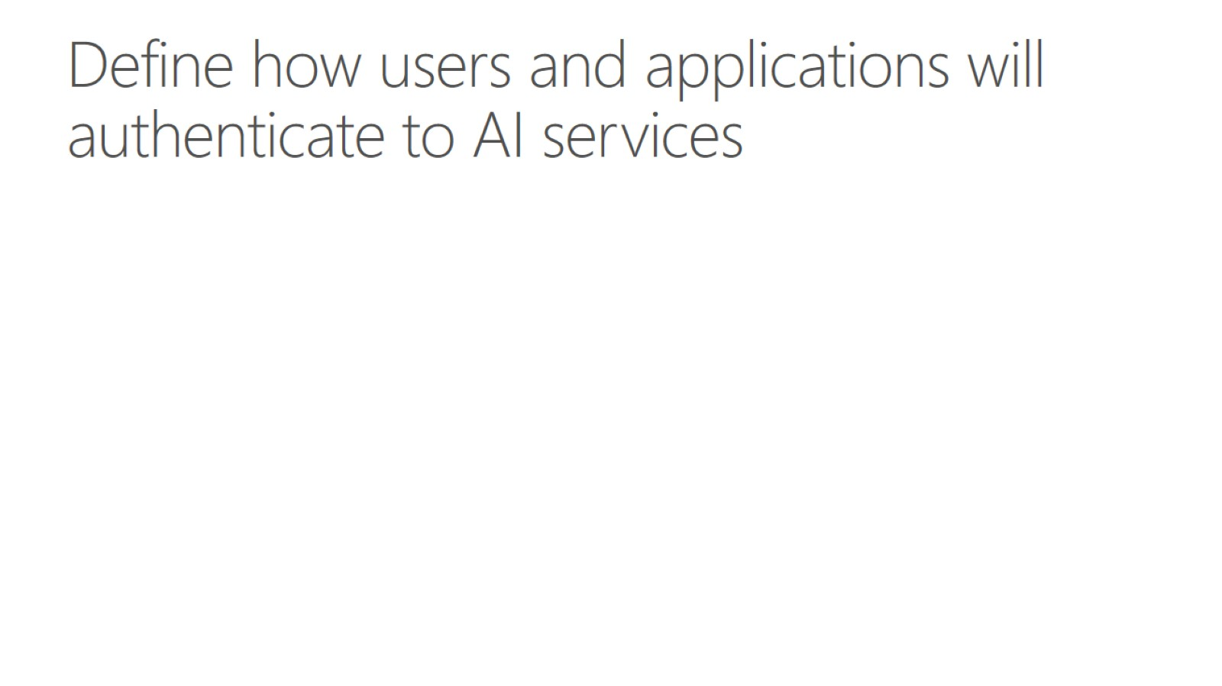
Define how users and applications will authenticate to AI services

Slide 51
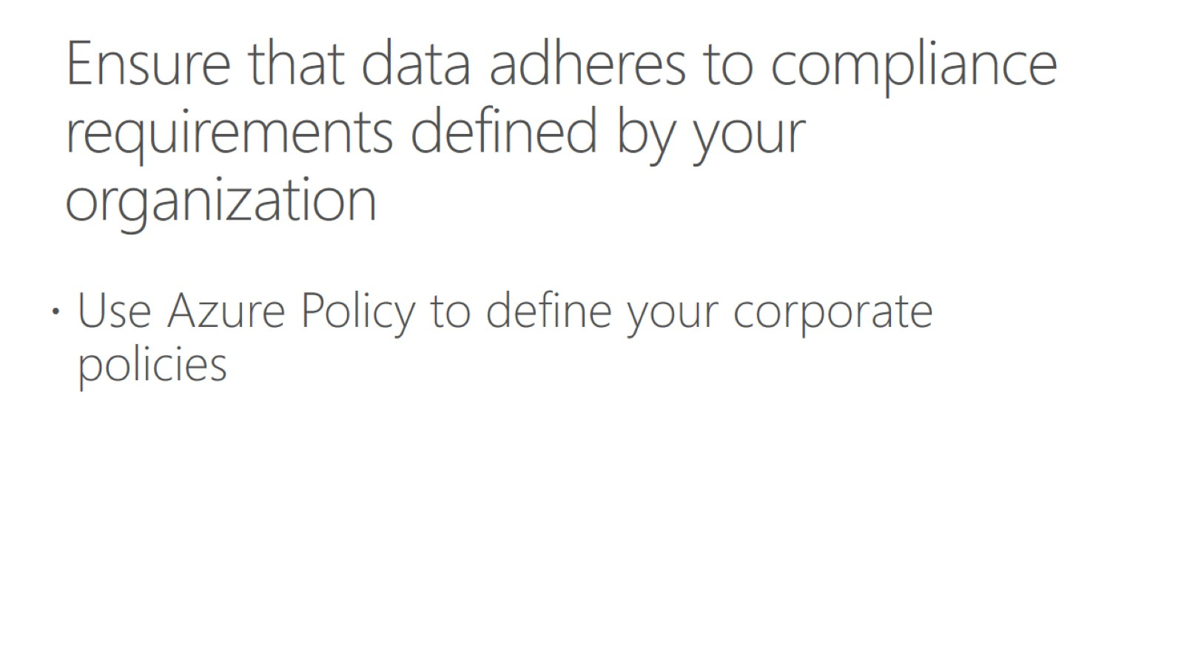
Ensure that data adheres to compliance requirements defined by your organization

Slide 52
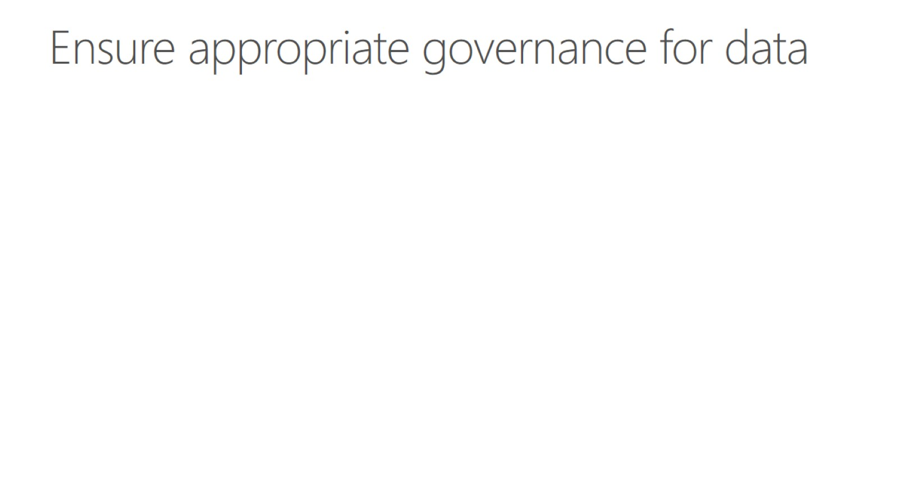
Ensure appropriate governance for data

Slide 53

Design strategies to ensure the solution meets data privacy and industry standard regulations

